Slide 1
SNJM Expansion
Session 7

Slide 2
Opening song
I have come to cast fire on the earth
How I wish, How I wish it were already burning
I have come to cast fire on the earth
How I wish, How I wish it were already burning

Slide 3


The miracle of the response to the call to mission
M
First mission: Beloeil, Quebec
Parish schools in the country
Areas of growth under M. Veronica: Timeline
M. Theresa: the 4 corners of North America
Summary

Slide 4
Areas of Growth
Date | Place | SNJM Sisters | Welcoming Clergy | Comments
1846 | Beloeil | Mother Theresa of Jesus with one other teacher and a housekeeper | Bishop Norbert Blanchet (who would receive the first SNJM’s in Oregon) Fr. Théophile Durocher, pastor, MMR’s brother | 31 boarders and 22 day Pupils. Novices vacation spot In 1852 housed the novitiate for a few years
September, 1848 | St. Timothé, 40 miles west of Longueuil on the St. Lawrence river | Sister Marie Madeleine, superior, and three other Sisters *Sr. Mary Patrick, 1st English-speaking choir Sister | Fr. Olivier Archambault, MMR’s cousin | MMR wrote eleven letters to this house that show how intimately she knew each of the Sisters.
September 1848 | St. Lin, 40 miles from Longueuil, on the North shore of the St. Lawrence | Sister Marie Ursule who had been a missionary in Beloeil. | Fr. Gerard Chabot who would become the chaplain of the Longueuil Mother House. He was a friend of Fr. Chiniquy | MMR wrote sharp letters to Sister Ursule.
1849 | St. Hilaire, across the river from the Beloeil mission | Send by Mother Veronica, then superior general | 1.7 | 7.0

Slide 5
Other foundations of Mother Veronica:
Beauharnois in1853, Verchères in 1856, St. Roch in 1857.
In April 1851, the new wing was added to the Longueil Convent.
At its completion in 1852, the sisters were to be properly housed for the first time since the foundation.
Foundations of Mother Theresa of Jesus:
1857 – Portland
1860 – Oregon City, Hochelaga Montreal
1861 – St. Paul, Oregon
1863 – Salem, Oregon
1864 – The Dalles, Oregon, Windsor, Ontario
1865 – Schenectady, New York, Jacksonville, Oregon, Rome, New York, Amherstburg, Ontario, Decatur, Illinois
1866 – St. Louis de Gonzague, Quebec, Valleyfield, Quebec
1867- Sarnia, Ontario
She had also prepared for the foundation in Oakland, California in 1868.
After her term as superior general, she was superior of Tallahassee, Florida and Key West, founded St. Joseph school in San Francisco.

Slide 6
4th Mother General, Sister M. Stanislaus
Surely but slowly restored peace within and outside the Congregation.
She would build it especially from within and strengthen the widespread foundations of her predecessor.
1874 – Winnipeg, Manitoba.
Biographies and publications:
A series of excellent circular letters by Pierre Duchaussois, OMI. Montreal
Rose of Canada by Sister Peter Gonzales SNJM.
Mother Mary Rose, a free translation of a work by Sister Catherine de Suede in Montreal, 1915. This small, unassuming work is possibly the best biography we have in English. It is especially good on the family background. It is rich in insights and is the only work we have in English by one of our Sisters who had lived for a long time in the places Mother Marie Rose knew.

Slide 7
I have come to cast Fire on the earth
How I wish, How I wish I it were already burning.
”
“

Slide 8
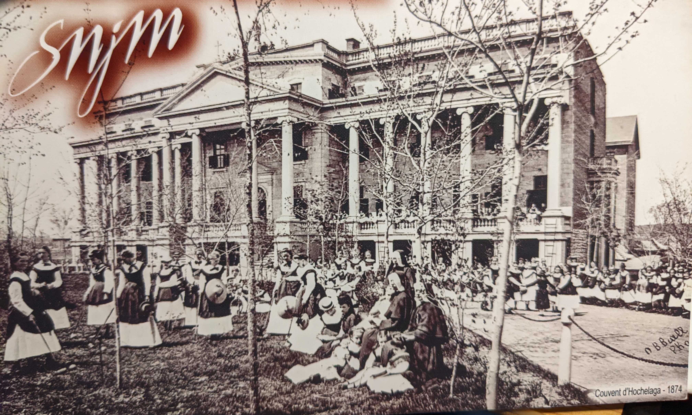
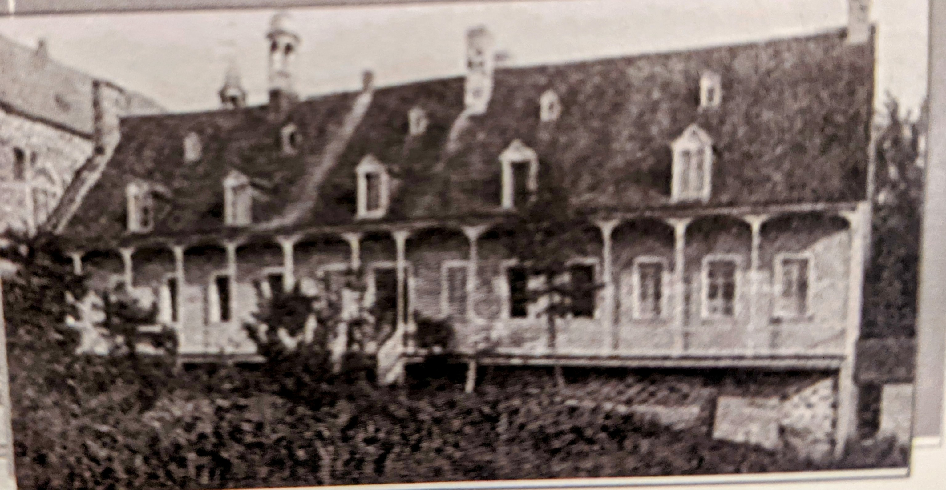
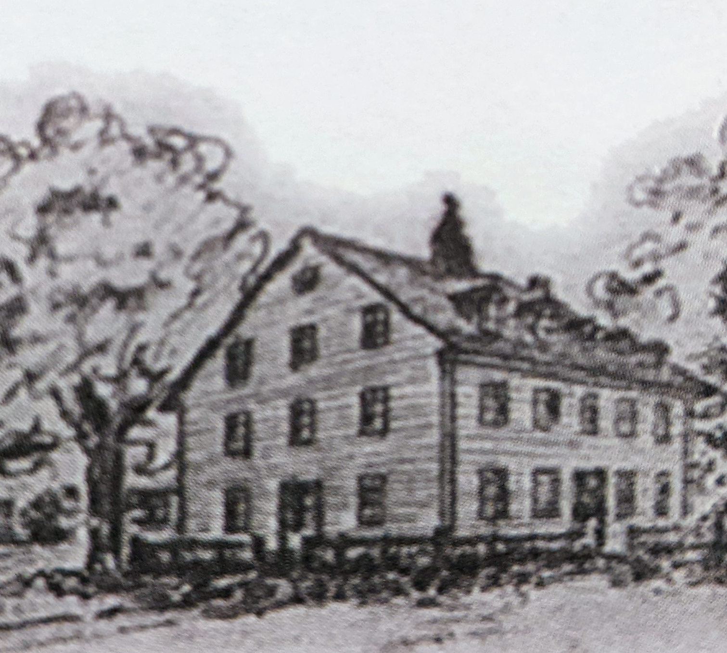
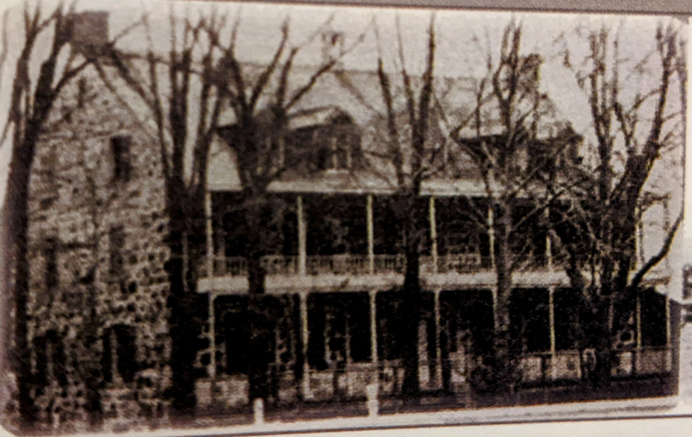
First four missions
St. Timothé​, Quebec
Hochelaga​, Quebec
1848
1860
Beloeil, Quebec
St. Lin​, Quebec
1846
1848

Slide 9
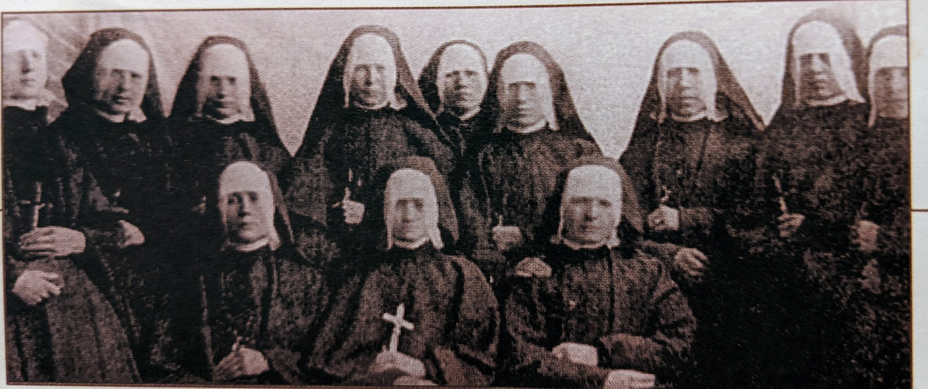
The First Group of Sisters to Oregon

Slide 10
Plenary Sharing
We will hear the story of the foundation of main region of our Congregation
as well as Peru

Slide 11
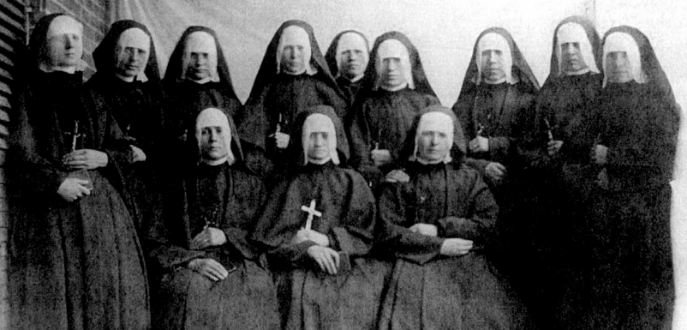
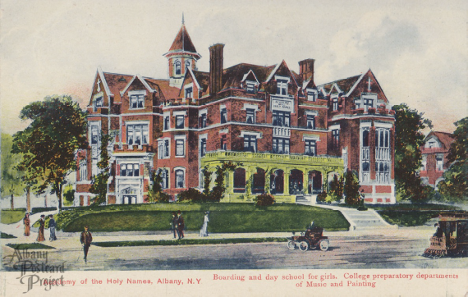
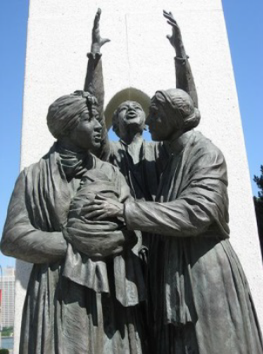
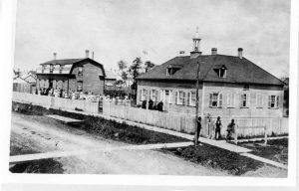
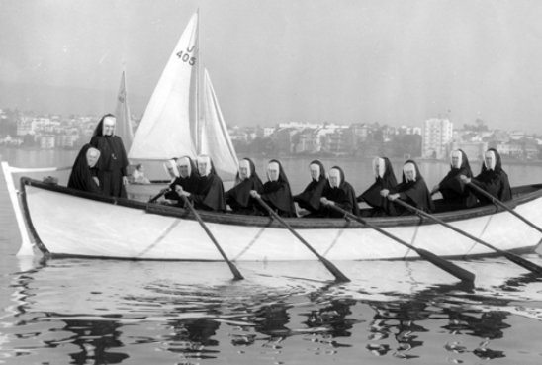
Expansion in US, Ontario, Manitoba
Portland, Oregon
Mary Ellen
New York​
Shannan
Windsor, Ontario
Sarah
1857
1865
1864
Winnipeg, Manitoba
Gringa
Oakland, California
Sharon and Mary
1868
1868

Slide 12
Areas of Focus
Why is the Expansion a Miracle?
When Mother Marie Rose died, after but six short years of religious life, membership in her Congregation had grown from four to forty-four.
In the peak years of its expansion, the forty-four became forty-two hundred.
At the time of her beatification,, Mother Marie Rose Durocher had given to society and the Church approximately seven thousand Sisters of the Holy Names of Jesus and Mary.
F
The Work of Education
The four houses she founded prior to 1849 were all confined within a small radius of the Province of Quebec. By 1960, two hundred and seventy-seven institutions were to be found in the central and western provinces of Canada, on the east and west coasts of the United States, and in Lesotho, South Africa.
Ever attentive to the call of the Church, Sisters of the Holy Names have continued to respond as a community to new needs and today are also present in Brazil, Peru and Haiti, and other countries
World war II necessitated our departure from Japan, where after a stay of nine years, we bequeathed a well-established school to Japanese Sisters of the Immaculate Heart. A commemorative bust of Narie Rose Durocher is to be found in the garden of the school. MMR gave a medal of St. Francis Xavier, that great Apostle of the Orient, to a young woman with the prophetic words: “Pray…for those of our sister who, later on, will go to distant missions”

Slide 13
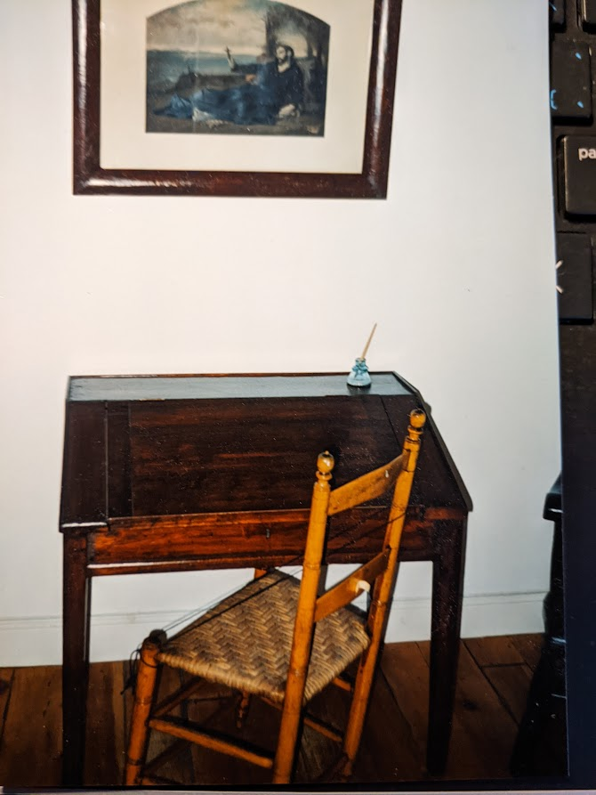
The Unity of the Congregation
The Warmhearted Letters of Eulalie Rose Durocher
In the detailed explanation that accompanied the votes of the judges concerning the heroic nature of Marie Rose Durocher’s virtues, before her beatification, one writes: “She knew how to imprint such a strong family spirit on the her Congregation that it has escaped fragmentation..”
One of her constant cares was for the unity of the Congregation.
The motherhouse at Longueil was to remain the heart of the Institute …
However she did not stifle the initiative and authority of the local superiors and reaffirmed their leadership.
In fact she did everything in her power to encourage and stimulate them.
One of the best means of assuring this unity was the numerous letters of encouragement and direction she sent to the Sisters – all of them very young, all of them her former novices
Another means was the frequent visitations made either by Marie Rose Durocher herself or by Sister Veronica who took a special interest om the studies and progress of both teachers and pupils.

Slide 14
The Interdependence
Mother Veronica of the Crucifix
The Printing of the Constitutions
Mother Theresa of Jesus
She shared the same spirituality as MMR.
She missed the support of Fr. Allard when he was replaced by a priest who knew very little about the life of teaching sisters and imposed strict penances on the already overworked sisters. Many young sisters died during that time. This led to divisions among the Sisters. The bishop, a strong supporter, ended his term in 1853.
She was the mainstay of the Oregon missions
Upon return to Longueuil, she was chosen as Assistant General during the second term of Mother Stanislaus
She became the untiring collector of the chronicles, letters, memoirs, etc., everything referring to the early days of the Institute and Marie Rose Durocher. Our valued archives remain first class to this day.
The constitutions were never applied exactly as written by the Marseilles SNJM community. At their arrival in Canada, they were given to Bishop Bourget, the first superior of the new institute. He studied them closely and made the adaptations immediately necessary for the application to Longueuil. The Sisters received the book of Constitutions on August 18, 1844, shortly after moving into the larger building. In August 1854 they were published in Montreal and Father Brassard paid for the printing. They were approved by Rome thanks to the persistence of Mother Veronica
Her life as an SNJM parallels that of Mother Veronica. MMR had great confidence in her talents as organizer and administrator.
She became general bursar from 1848-1853 at the same time as being General Directress of Studies.
Named superior general in 1857-1867, her term of office is renowned for the rapid expansion of the Community. Oregon and Hochelaga (which became the Mother House and novitiate) would profoundly change the physiognomy of our Institute, from small town schools to huge institutions in huge cities.

Slide 15
Expanding to Associate Belonging and the Transformation Process
Presented by Gringa Orbegoso

Slide 16
Thank you
… for all the contributions to this presentation from the various corners of the congregation

Slide 17
Jesus and Mary My Strength and My Glory by Marianne Misetich
Jesus and Mary, my strength and my glory
I believe in God, I hope in God,
O help me love my God with all my mind
Jesus and Mary, my strength and my glory
I will work for God, will honour God,
O help me love my God with all my heart.
Jesus and Mary, my strength and my glory
I will live for God, will die in God,
O help me love my God with all my soul.

