Slide 1

Out of Adversity Springs New Life
Sessions 5
Formation of Associates
This Photo by Unknown author is licensed under CC BY-SA.

Slide 2
Opening Song
Psalm 63
(Marjorie) As Morning Breaks, I look to you
I look to you O God to be my strength this day
As morning breaks, as morning breaks
(after verse 1 Play the rest and join in:
https://youtu.be/V-H4VcVfh94

Slide 3

Questions for Small Groups
How did New life emerge from difficulties and losses in your life?

Slide 4
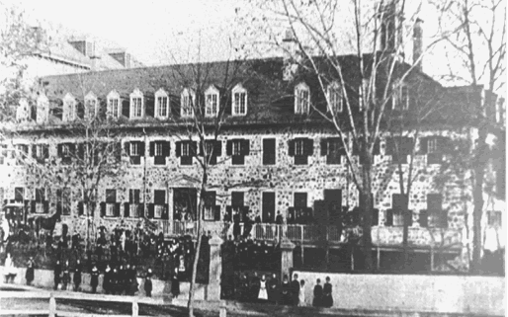
Beginning of Difficulties with Father Brassard
In her personal journal for November 15, 1847, Mother Marie Rose has this brief entry: “Some disagreement concerning our Community has begun to be felt in the strained relations existing between the pastor and the Oblate Fathers” (Positio VI:45)
She touches here on the real cause of the difficulties that will threaten the young community and whose resolution she will not live to see.
Right: drawing of the Longueuil large school, before extensions

Slide 5
Financial Difficulties That Ensued
Letter from the pastor to the bishop saying he would have nothing to do with the convent
March 1848, he obliged the sisters to take out a mortgage of $5000 on their property, of which he was the beneficiary ($600 a year plus interest)
In May 1848, he required the sisters to pay the interest on the land he had bought and of which he had made “a gift pure and simple… gratuitously without any charge or remuneration,” threatening to bring them to court if they did not agree.

Slide 6
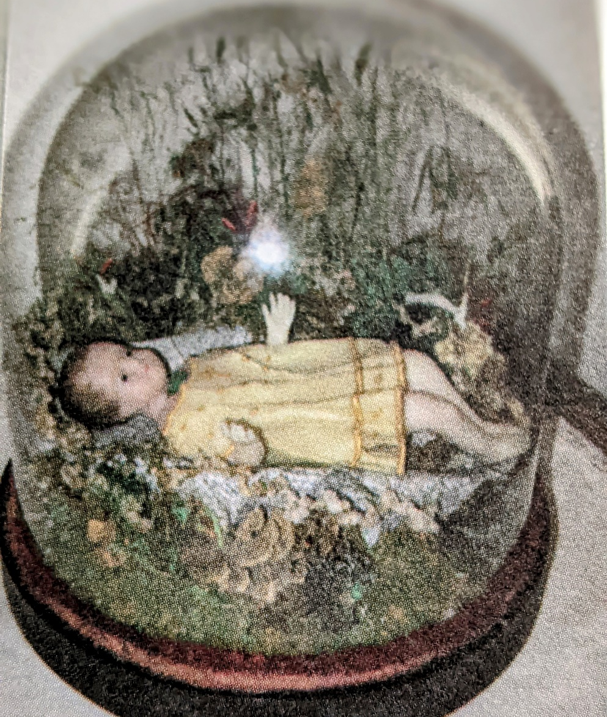
How They Paid the “Debt”
They cut back on expenses as much as possible, however, without letting the children suffer.
They multiplied their activities making bread, hosts, artificial flowers then very much in style.
They benefitted by the generosity of several friends, one among them leaving a legacy. The Durocher family came to their help.
Through it all Mother Marie-Rose proved herself to be a very wise and prudent financial administrator.
At the time of her death Mother Marie-Rose left a small surplus.

Slide 7
December 1847: Demands for Money
The generosity of Father Brassard is the chief reason for the choice of Longueuil for the foundation of the new Institute.
He has welcomed and supported the Oblate Novitiate. He was the eloquent spokesman for the new school with the members of the parish board. From them he obtained first the use of the foundation house and in August, 1844, the larger former hotel on two adjoining lots.
In all their transactions, he was the guide and advisor of the Sisters.
He never signed the very detailed deed of May 1946. All the additions and extensions were done under his guidance and encouragement.
Right: photo of school with extension

Slide 8

Continuation of the Difficulties:
False Reports and Rumors
July 1847: a conscious attack in order to oust the Oblate Fathers. At its source was a priest of the diocese of Quebec, a pupil and protégé of Fr Brassard, who entered the Oblates: Charles Chiniquy, a dynamic preacher on temperance
In the notes which she left for a projected history of the Congregation , Mother Theresa writes, “Although the reasons have never been openly discussed…”
She then gives her view of the influence of Chiniquy on the troubles. Until the publication of the Positio, all the biographies were discreet almost to the point of silence on the source of the troubles although it was well-known within the Community. When the first biography of Fidelis, on which all the others depend, was published in 1894, Charles Chiniquy was still alive, living in Montreal and using his vigorous pen to slander the Church to which he had once belonged, so that prudence was necessary.
July 1847 Typhus epidemic
upon the arrival of Irish refugees and cancellation of the student public exams: the pastor acted like an inquisitor at the private exams.

Slide 9
Letter to Bishop Bourget
Longueuil, December13, 1847
Your Excellency,
It is impossible for me to express in a letter what I would like to lay before.
The Reverend Pastor has refused to have a meeting with us. He simply wrote he was leaving on a trip, notifying us at the same time that we were to pay 300 francs as interest due the fifteenth of this month. To carry out your wishes we should like to confer with him about several material items that must be taken care of at once.
You recommended that I speak about the ember days so that you could arrange for an extraordinary confessor.
We beg you to let us know the day we can go to Montreal to receive your advice.
In the meantime, I beg you to believe me, with deepest respect,
Your humble and obedient daughter,
Sister Marie Rose

Slide 10
Letter to Bishop Bourget
Your Excellency, Longueuil, December 17, 1847
I was hoping to consult you about our business; but since the crossings are so bad, I shall have to do the business by letter.
I asked for an interview with the Pastor to discuss the furnishings in the house. It was refused. I beg you to grant us permission to act without his advice for day to day business until such time as he will be willing to listen to us. ….
… As for myself, I can only bemoan my miseries and those I cause others by my imprudence and little virtue. In the absence of the Pastor, I saw Father Chiniquy, who asked for an interview to discuss matters touching the Pastor, the reverend Oblate Fathers, and ourselves. He told me about the meeting he had had with Your Lordship. I do not know what will be the result of all this, but I hope God will have mercy on us. I find our situation very painful. It appears the majority of the parishioners are very worked up. Each day we beg God to draw glory from our distress, to give light to our Superiors, and to us patience and submission.
Do you think I should ask again for an interview with the Pastor? It seems to me it would be useless. I should have preferred to have talked about this with you, but God did not so will. Pardon these poorly formed sentences which come from a suffering heart to go to him whom I revere as my Superior and in whom I place my confidence.
While awaiting your answer, please bless her who considers herself happy to be,
Your very humble and obedient daughter,
Sister Marie Rose

Slide 11
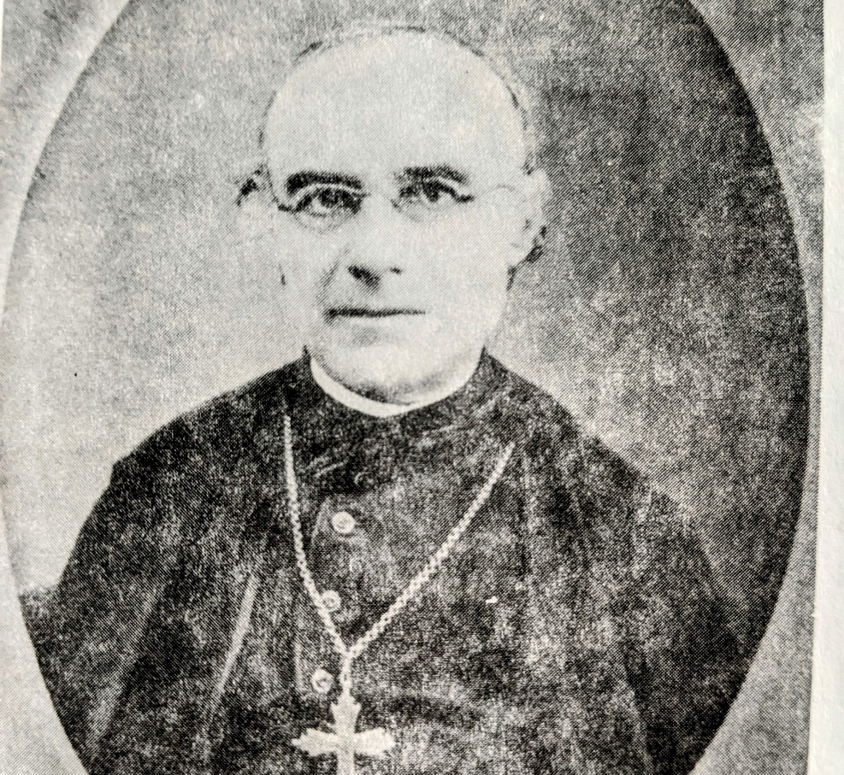
October 1847, patronal feast of Fr. Allard
O.M.I, novice director and pedagogue.
The feast was celebrated with the usual compliments, expressions of admiration and gratitude and giving of small handmade gifts.
After assisting at this celebration, and listening to praise given to another the pastor in his letters showed a growing discontent up to the point of considering himself as the real founder of the community (Positio IV:134)
A rumor campaign against the school and the Sisters was spreading through the town and the diocese. Some were so crude that it is hard to understand how anyone could believe them.
The pastor withdrew his niece from the school and openly criticized the school, its teaching methods and curriculum. The enrolments grew anyways.

Slide 12
Letter to Bishop Bourget
Your Excellency, Longueuil, January 12, 1848
In sending you now the regulations for the boarding school pupils, I ask you to pardon me for not having sent them sooner. I am at fault.
I beg you to grant the request I made concerning the arrangements with the Revered Fathers, the Pastor, and ourselves by giving me the note touching the matters of which you spoke to me in their presence.
You know, Your Excellency, that it will be almost impossible for the Pastor’s moral wounds to heal quickly. Having to confer with him, I need to be very certain of my ground so as not to irritate him further.
Oh, how difficult it is to get along well with persons who do not understand religious life! It is above all in these painful moments that we appreciate our happiness in being directed by priests who are religious. We can never thank you enough for this favor. May we always have it! It seems to me that I could gladly endure the lack of material things. When there are those who tell us we are too pious…
Recognizing in your person the goodness of God and filled with confidence, allow me at your feet to beg your blessing for my sisters and myself, so that God will give us the courage to suffer all and that He may give me prudence. I beg you to believe me with deepest respect,
Your very humble, obedient daughter and servant,
Sister Marie Rose, Superior

Slide 13
Causes of the Difficulties with Fr. Brassard*
The Pastor may have been imprudent in being generous beyond his means since he had to borrow heavily.
The crops of the parish had been very poor so that the tithes he received were much less than he had reason to expect.
He was a sick man during the years 1847-1850 suffering greatly from rheumatism and headaches.
However, none of these reasons, valid as they are, would have brought the radical change; the reasons to be found are in the influence of his protégé, Father Charles Chiniquy, a popular preacher and former Oblate novice. He succeeded in convincing his benefactor that a grave injustice was being done to him by the role of the Oblates in the Convent.
There always existed in Quebec among the French Canadians a certain animosity towards the French from France, and all the Oblates were Frenchmen. It was on this feeling that Chiniquy played, hoping to oust them and become himself the chaplain and director of the school. At the same time he wished to ingratiate with the foundress and the Sisters so as to be accepted for the position he desired.
M. Marie Rose from the beginning had an intuition as to the type of person he was and refused him any contact with the school.
*All of Document VIII, Positio IV:119-145, is on this subject)

Slide 14
Tensions between the clergy
Mother Marie-Rose wrote to the bishop about many other difficulties within the convent causing more suffering than from outside: for this she offered her resignation. The Oblates, especially Father Allard, were also responsible, being too exacting and too unbending in their requirements

Slide 15
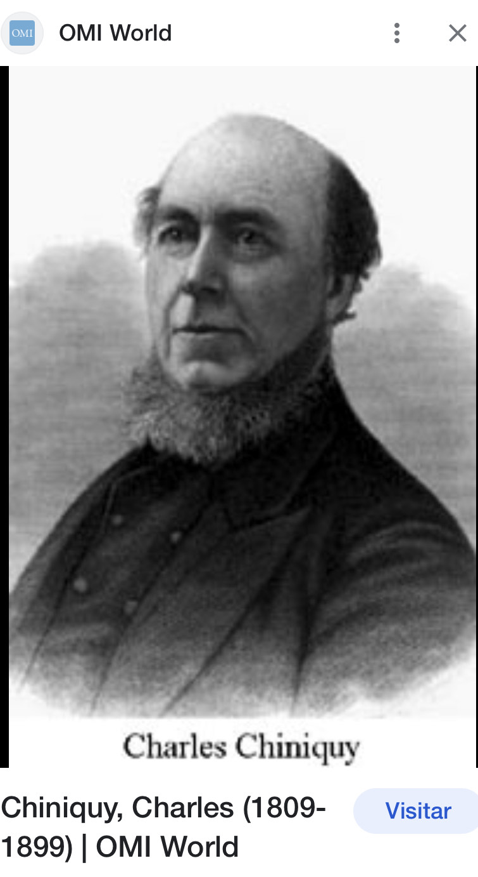
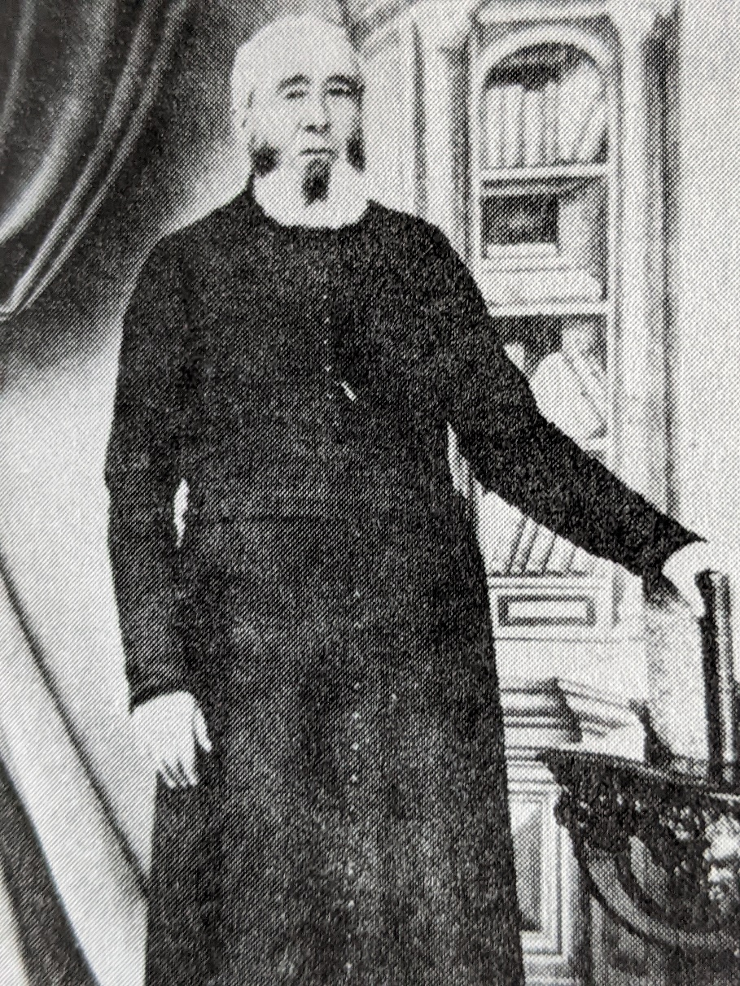
Father Brassard Father Chiniquy

Slide 16
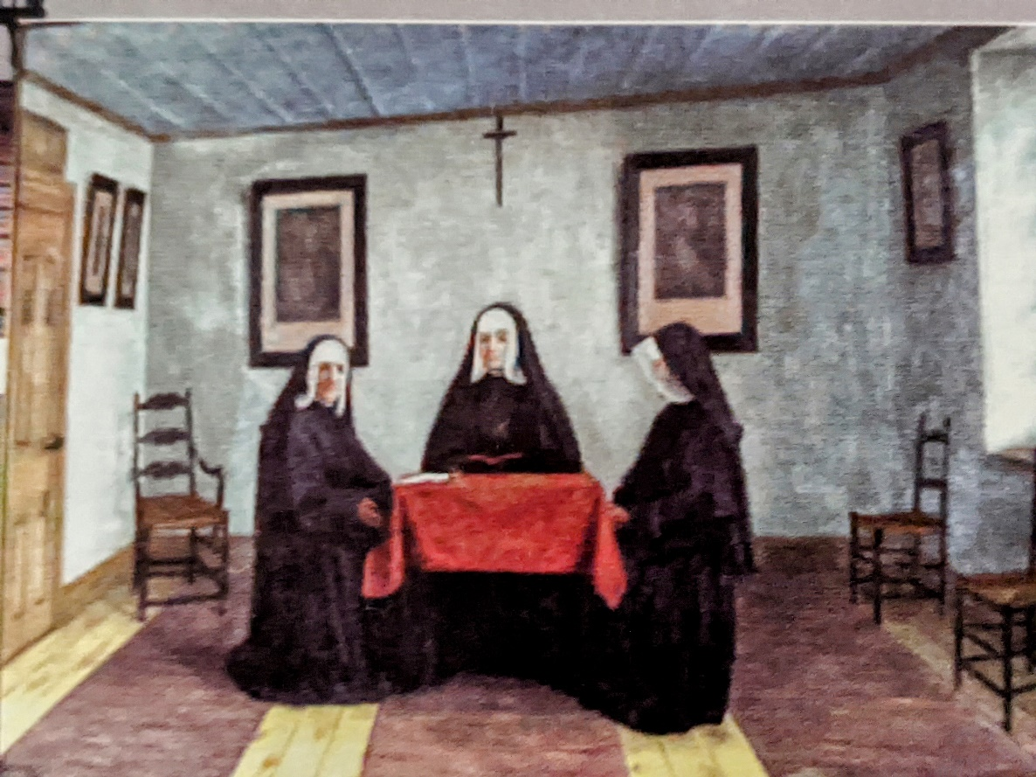
Letter to Father Brassard, Pastor
Longueuil, December 30, 1847
Reverend Father,
The Community of the Sisters of the Holy Names of Jesus and Mary with pleasure see the day on which they may extend their greetings to you. Allow us to tell you, Reverend Father, that we appreciate all your kindness. The gratitude it deserves is written deep in our hearts and nothing will be able to efface it. It gives us joy to place the expression of it before.
As for our dealings one with the other we have only one thing to say and always the same thing, namely, that we are following all regulations made by the Bishop. Please allow us to ask for a place in your prayers and be assured of the sincerity with which I am, with deepest respect,
Your very humble servant,
Sister Marie Rose

Slide 17
To Father Brassard
Longueuil, March 28, 1848
Reverend Father,
We are very grateful for the use of your piano which you have let us have for several years. Your request for its return is very just. We are resigned in this matter as in others. We recall that when the last piano was purchased we asked you to choose whichever one you might wish. What we said then we now repeat. You may take whichever one will suit you best, and you may have it today if you wish. We still have three tables that do not belong to us and I shall have them taken to you as soon as possible. We do not know whether we have other things in the house belonging to you. If you recall any other items, please let me know.
Please accept our gratitude for all your kindnesses.
I remain,
Your very humble servant,
Sister Marie Rose

Slide 18
Infirmity
Throughout the life of Eulalie Durocher there is question of her delicate health. Her brother Calixte tells us that she suffered from “stomach trouble.” She came from a healthy family. Both her parents lived to old age; her mother died at 63, her father at 88. Three of her brothers, Flavien, Calixte and Eusebe celebrated their 70th birthdays, and although none of the others reached 50, Marie Rose at 38 was the youngest at the time of her death.
For many years before the foundation of the institute, Marie Rose Durocher seems to have suffered from tuberculosis. Many of her letters refer to her ill health which she tries to disregard. Although her health was undermined, it was only during the last year of her life that it caused real anxiety; by September, 1848, all those with whom she lived knew she was weakened and suffering. Certainly the trials of the congregation and the added work undertaken to meet their financial obligations were taking their toll. She was carrying the burden almost alone in order to spare her companions

Slide 19
Final Illness
Before beginning her last month of May, Marie Rose Durocher wrote out her act
of consecration to Mary. This is the longest and most complete witness we have
of her spiritual life. In the prayer written at the end of the month which is incomplete, she says, "You see the state of feebleness and illness to which I am reduced… I believe I have only a short time to live.”
The last grace she asks is “Protect my last hour.” Still she continued her work, seeing the sisters and writing numerous letters.
The immediate cause of her death was a chill she took and a cold that followed after a long walk in the icy spring rain of 1849.
She had arrived in Beloeil by public transportation and rather than pay for a carriage she walked the two miles that led to the convent.
She was exhausted when she arrived there and at her return to Longueuil the sisters were alarmed at the rapid change. From the beginning of June until her death four months later she had only short periods when she was able to leave her room.

Slide 20

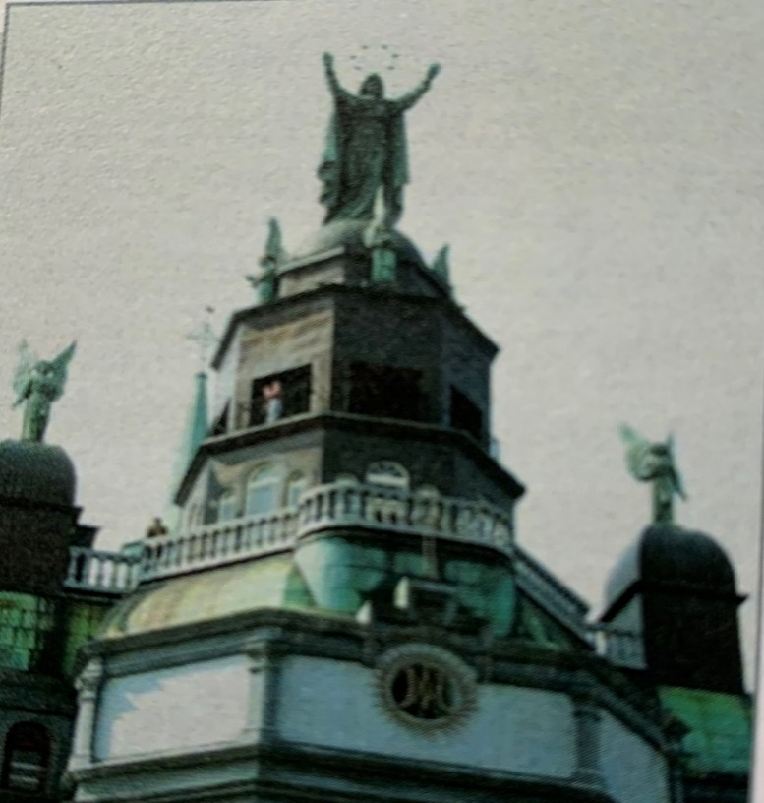
Prayers, Last Anointing, Asking Forgiveness
The sisters prayed intensely for their dear mother’s healing
They promised a light in perpetuity at Mary’s altar
They brought roses to the church of Bonsecours in Montreal. Still her health declined.
On her last feast day, St. Rose of Lima, she joined the community for the celebration, and when it was over she asked for the last rites.
When the bishop’s auxiliary came for this occasion, she composed a confession of her faults and asked pardon of the sisters. Since she was too weak she asked Sister Veronica to read it.

Slide 21
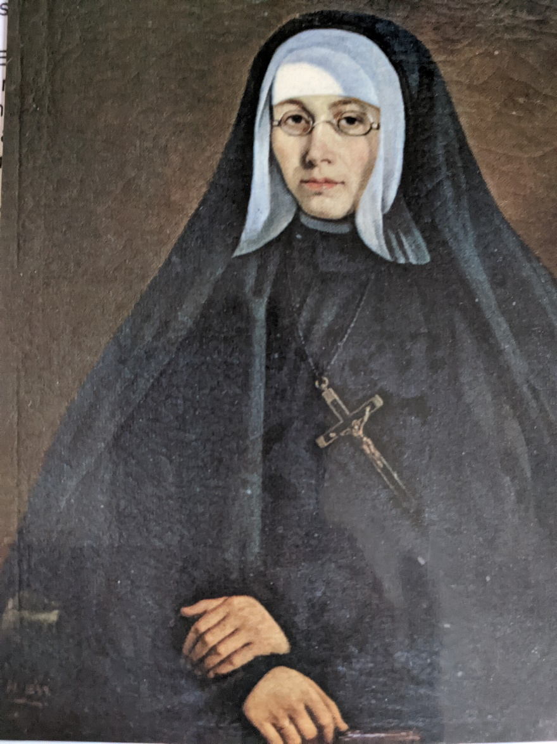
Portrait
The sisters wished to have her portrait painted but she would not hear of it. Their desire was made known to Bishop Bourget who obliged her to comply with her sisters’ wishes. One of Montreal’s leading portrait painters, Théophile Hamel, was engaged. Since he could have only one sitting with the dying woman, he had her photo taken to help him with his work. He worked with great speed and finished it so that on October 8th, when the sisters returned from her burial, her portrait was in the chapel before Mary’s altar, near the spot where she so often prayed at night.

Slide 22
Funeral and Burial
Her death took place at 12:15 a.m., Saturday, October 6, 1849, her 38th birthday. The sisters were told only in the morning. Her body was first exposed in the chapter room where she had died. Later it was brought to the chapel under the direction of Father Telmon. The sisters saw in this a grace given to the priest who had directed her towards the foundation of the Community. Her funeral was celebrated on October 8th, first in the Convent chapel by her brother Théophile for the sisters and pupils, then the body was transported to the church for the veneration of the townspeople. Later the same day Bishop Bourget presided at the solemn funeral Mass provided by the parish. The Trustees carried her coffin to its final resting place in the crypt beneath the Convent chapel beside Sister Marie André, the first Holy Names Sister to die.

Slide 23
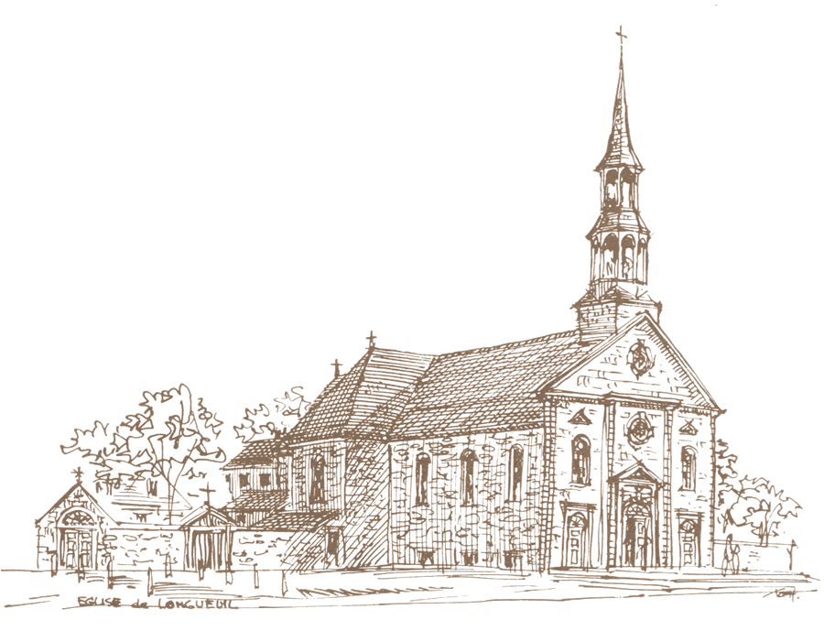
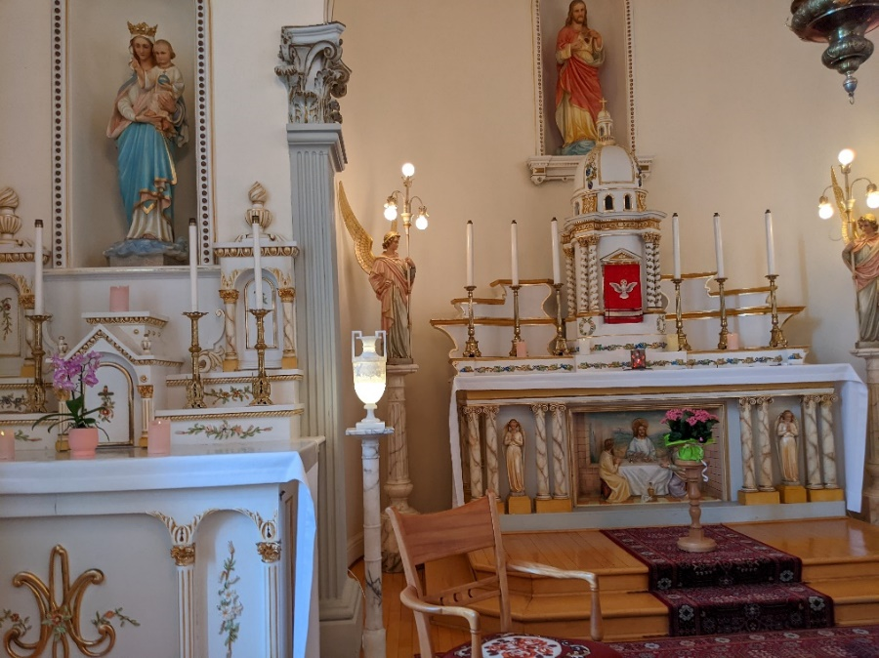
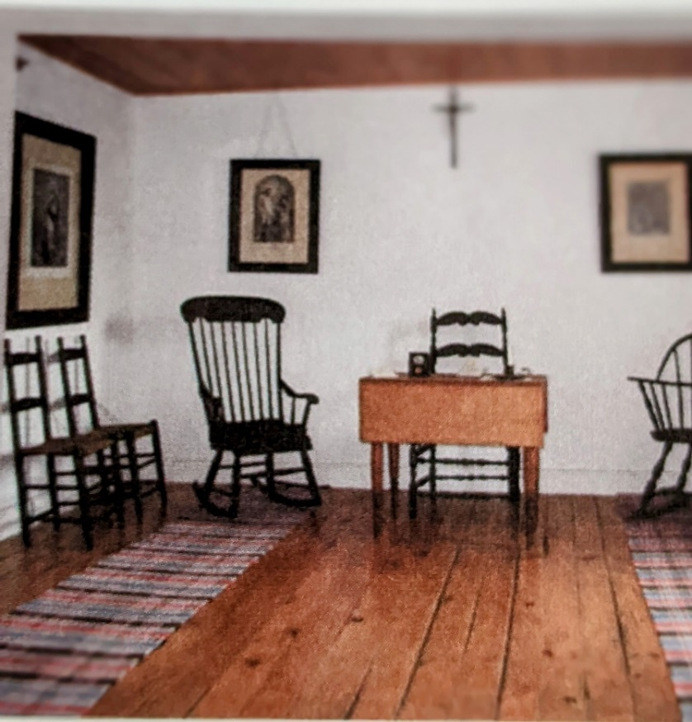
From Chapter Room to Chapel to Parish Church

Slide 24
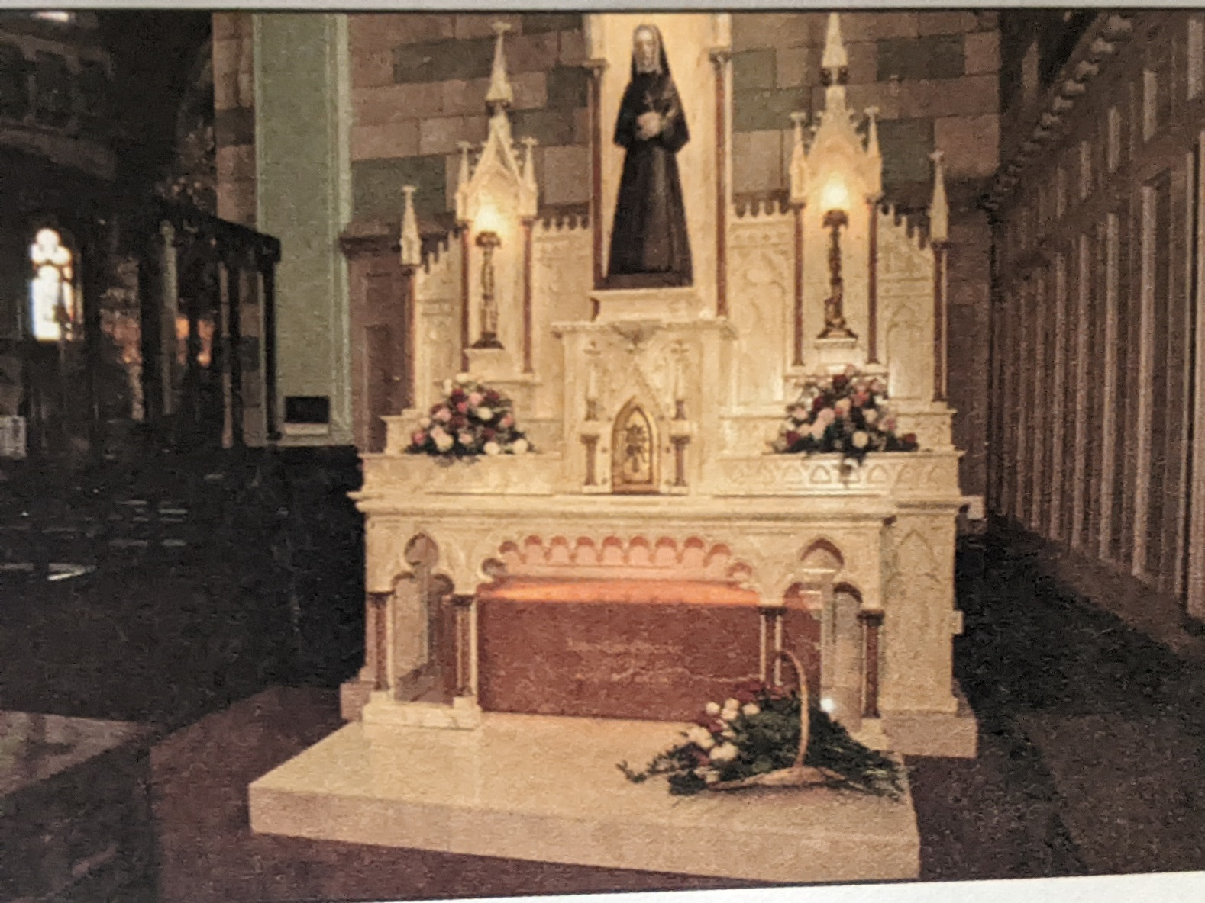
Final resting place in the Marie Rose Chapel in the Cathedral in Longueuil

Slide 25
Mother Marie Rose Durocher’s
Favorite Hymn
Je mets ma confiance Vierge, en votre secour. Servez moi de défense, prenez soin de mes jours.
Le Coeur plein d’espérance Vierge, à vous j’ai recours
Soyez mon assistance en tout lieu et toujours
Et quand la dernière heure viendra fixer mon sors
Obetenez que je meure de la plus sainte mort.

Slide 26
Bishop Interviews the Sisters, Believing Mother Marie Durocher to Be a Saint
Despite his numerous and important occupations, Bishop Bourget remained at the Longueuil Convent until October 12th. He saw each of the sisters in order to collect their memories of Marie Rose Durocher and the first days of the Community. This was to serve as the basis for the Chronicles, and at the date of October 6th the notice on the foundress has come to be known as “the first biography.” This was finished in November, 1850, and the bishop gave much importance to the work he was composing. Since he had been closely associated with the Institute since its beginning, and since he was the confidant of Marie Rose Durocher in her difficulties, he was in an excellent position to complete the work.

Slide 27
Constitutions: the Names of Jesus and Mary
In fidelity to the spirit of our Foundress,
We are a community of women religious
Consecrated to God
In the Names of Jesus and Mary,
who desire to proclaim by our lives
the primacy of the love of God.
Moved by an active love,
we collaborate in the
Church’s mission of education,
with emphasis on education in the faith,
and with a special concern
for the poor and disadvantaged.
Our mission is rooted
in our spirituality,
which is inspired
by the Names of Jesus and Mary.
United and missioned
In the names of Jesus, our Savior,
and of Mary his Mother,
we enter into the mystery of their lives
through prayer, silence and contemplation.
Inspired by their example,
we desire to live in openness to the Spirit,
available to the needs
of the Church and the world.
in Jesus and Mary
We find our strength and our glory.

Slide 28

The legal seal of the Congregation
Possible meaning for today:
the three foundresses united and strengthened in the love of Christ
The three vows being a total gift of self in love with the help of God, living out the paschal mystery
The paschal mystery lived out in community – Any other thoughts?

Slide 29
Apostolic Community
An essential element of our religious life
is community living.
In the name of Jesus
and through his abiding spirit
we are united as a community of love
to share in his mission.
In communion with one another,
as individuals and as a community,
we call each other forth
to live the Gospel every more fully,
and send each other forth
to minister and to proclaim
the Good News of salvation.
The love of Jesus calls each of us
to human and spiritual growth
and strengthens our unity
with one another.
It is by faith that we live with those
with whom we are missioned,
and appreciate the profound mystery
of each sister.
The experience of God
lived and shared in our local group
becomes a concrete sign
of humanity reconciled in Jesus.
In a sprit of hospitality and caring,
we extend the bonds which unite us
to those we serve.

Slide 30
Acts of the 31st General Chapter 2001
“We are Called to Be Women of the Eucharist”
As Eucharistic women,
women of the Word,
women of communion
women of thanksgiving,
women of justice,
women of hope
We believe
That life is stronger than death; that the Paschal Mystery is at the heart of our lives.
That authentic celebration of the Eucharist
Transforms us and empowers us to give birth to a new creation.

Slide 31
Moved by our desire to gather as one,
to celebrate our identity and to be energized for mission
We hear again those voices identified in the 1996 Act, Eucharist in our Lives.
We encourage the Congregational and Provincial Leadership Teams to provide biblical, theological and liturgical experiences such as the Eucharist Study Week of June 2000
We invite one another to develop rituals which celebrate our experience, the cycles of our lives, and the cycles of creation in light of the Paschal Mystery.
We encourage one another to break open the Word in faith-sharing communities.
We commit ourselves to explore significant questions in light of current liturgical theology and liturgical spirituality, such as,
    The language of symbols,
    the understanding of “real presence,”
    the role of the presider at the Eucharist
    We challenge one another to speak and to act regarding the question of who is welcome at the Table
    We commit ourselves to reclaim the healing and transformative power of Sabbath
    As Eucharistic women, we hold the creative tensions regarding Eucharist with all who share them.
    With all creation, we work toward the day when all will be reconciled in the New Creation.

Slide 32
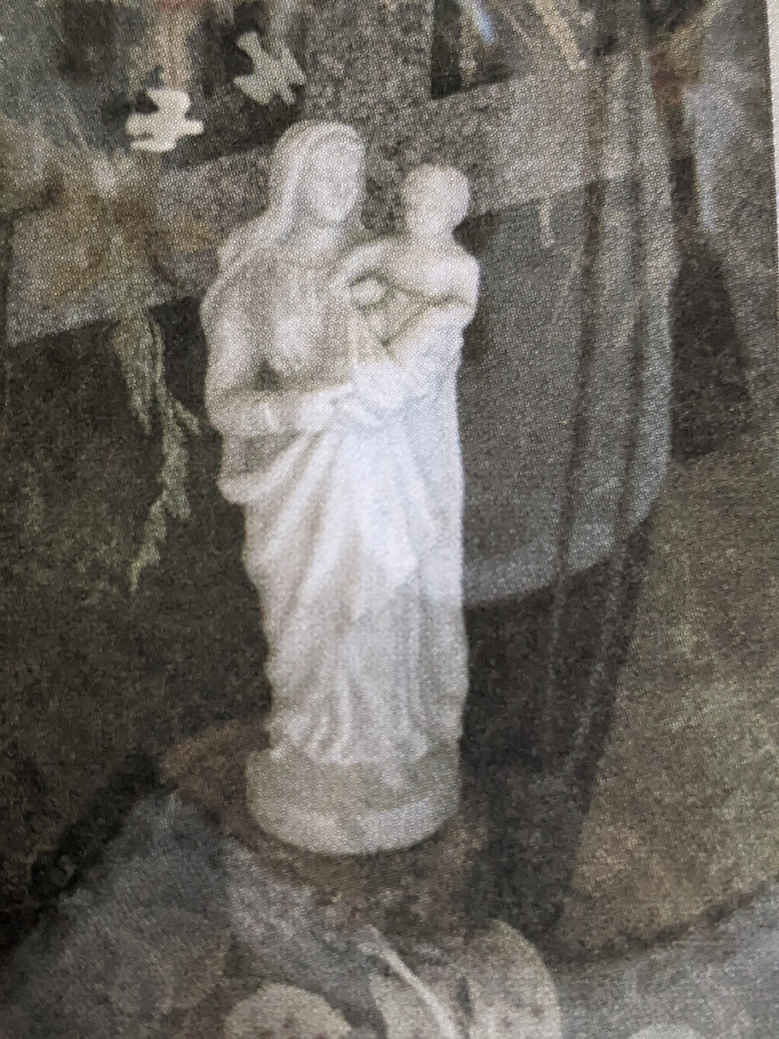
Jesus and Mary, My Strength and My Glory
Jesus and Mary, my Strength and my glory
I believe in God, I hope in God,
O help me love my God with all my heart
Jesus and Mary, my strength and my glory,
I will work for God, will honor God
O help me love my God with all my mind
Jesus and Mary, my strength and my glory,
I will live in God, will die in God,
O help me love my God with all my soul.
(Agnes’s artwork)

Slide 33
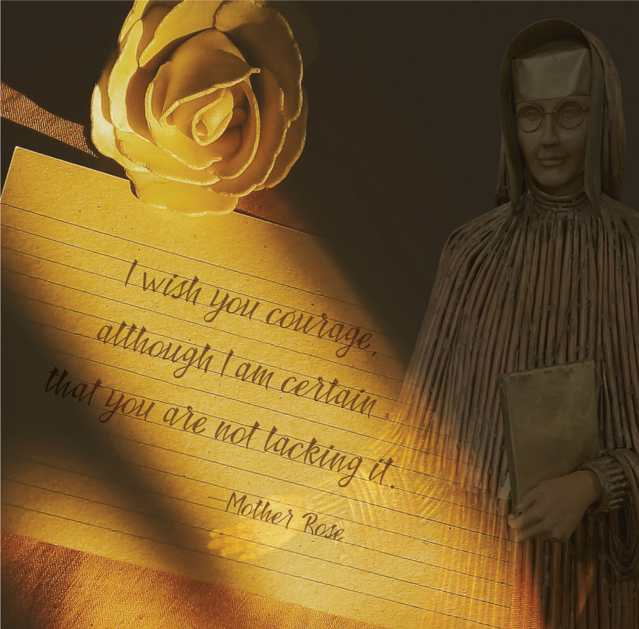

Slide 34
Questions to Ponder for the Next Meeting:
Call to Justice
What has been your response to the injustices in your life?
How did those injustices awaken in you a deep thirst for justice? Describe some of the emotions that accompanied that thirst.
How did you put that desire for justice into action?
Were there times when you did not act? If so, how did your feelings get expressed - constructively? - destructively?

