Slide 1
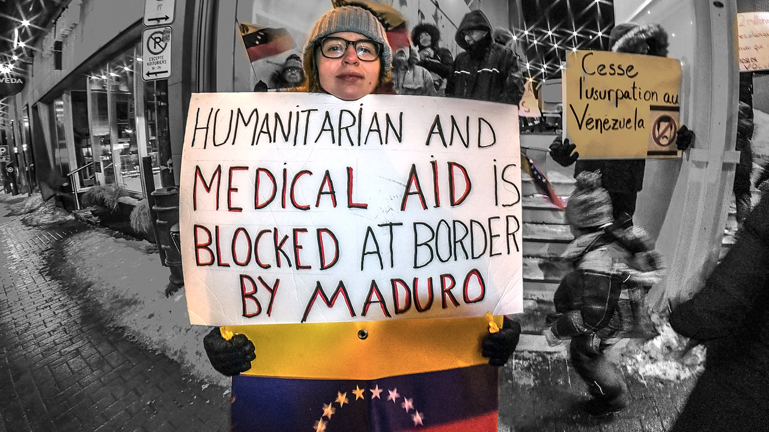
SERVICE
WOMEN OF THE CHURCH
Session 4
This Photo by Unknown author is licensed under CC BY-SA.

Slide 2
Opening Song: Somewhere to begin https://www.youtube.com/watch?v=ei54clvS1m4&authuser=0

Slide 3
Questions for the small groups
Looking back at your life, how did the call to serve begin?
    in your family?
    in the church?
    in your community?

Slide 4
Eulalie's call to serve
Factors that led up to the foundation of the congregation:
  Bishop Bourget's insight into Eulalie's character
  Meeting Hedwidge Davignon on Mt. St. Hilaire
  The confraternity of Mary Immaculate (Children of Mary)
  Her dream of a school for each parish
  Resistance from her brother-pastor-Father Theophile
  Her education, knowledge of the needs of her time, wisdom

Slide 5
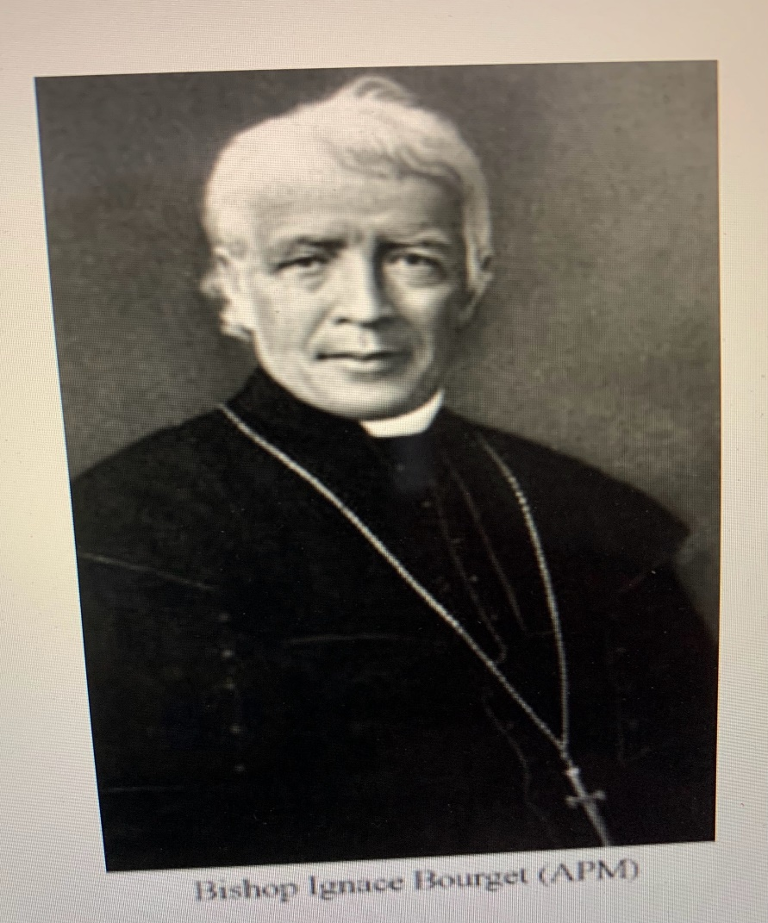
Bishop Ignace Bourget

Slide 6
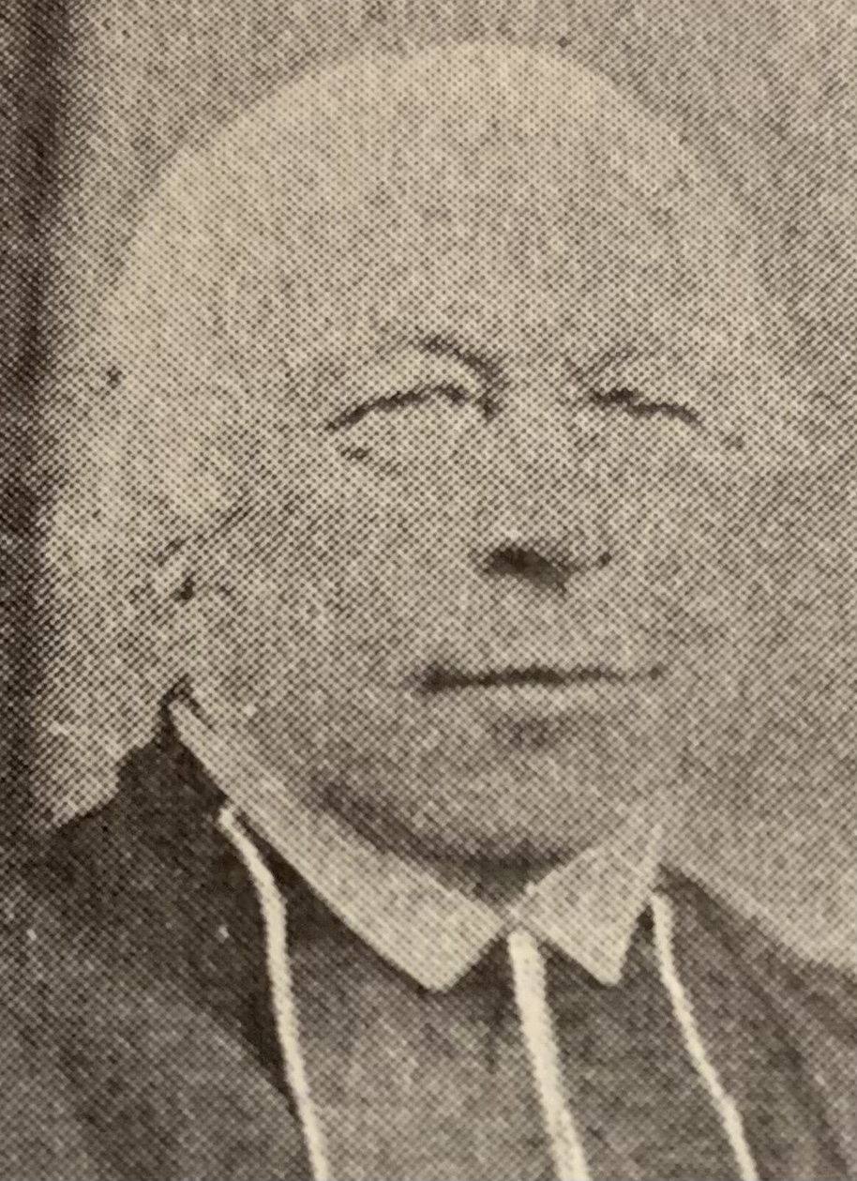
Father Eusèbe Durocher her brother

Slide 7
Marie- Rose's manner of service:
Compassionate listener and educator as pastoral assistant in Beloeuil
Novice: Portress
Vowed religious: superior of the congregation
Discernment of spirits and gifts in others
Letter writing
Conciliator and collaborator

Slide 8
The quality of education in the school under her leadership
Eulalie – Maire-Rose: the values and atmosphere in the school:
(place of prayer, the arts, recreation, courtesy, kindness, nature walks, gardening etc.
Melodie – Marie-Agnes in the arts and direction of the house
Henriette – organization and direction of the school
Salome – Teresa of Jesus business with heart for mission
Hedwidge - Veronica of the Crucifix in designing curriculum, books, etc.

Slide 9
Historical and social events leading to the foundation
Armed rebellion against the English, anti-clericalism: church seen as upholders of the "status quo"
Arrival of Bishop Bourget in Montreal, then the Oblates of Mary-Immaculate
Protestant Evangelical movement in Montreal and surrounding country-side.
The temperance movement, very successful. The bishop invited the Holy Cross, Sacred Heart and the Oblates to promote it.

Slide 10
The publication of a Roman Catholic bulletin to counteract the evangelical propaganda
The government of Canada encouraging each town to have its own school. The bishop requesting each parish to have its own school. Eulalie Durocher shared this dream, especially for disadvantaged girls in the county villages.
Helping found a religious congregation became popular among young girls, lots of candidates.

Slide 11
The bishop's interest in every detail of the foundation
The refusal of the Sisters of the Holy Names of Jesus and Mary to cross over to Canada from France.
Eulalie did not have the encouragement of her family and founded the congregation out of obedience to two bishops and her own interior discernment that it was the will of God.

Slide 12

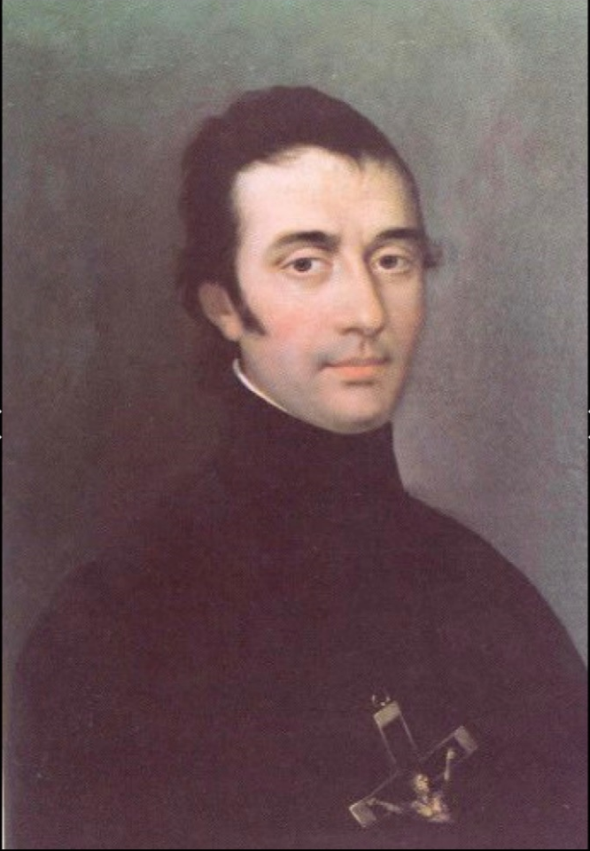
The two bishops Ignace Bourget in Montreal and Eugene De Mazenod of Marseilles, both asking the three women to found a congregation.

Slide 13
The foundation
The letter to Melodie could be considered the call to found the congregation, for Melodie to join her and for her to invite Hedwidge Davignon (later Veronica of the Crucifix)

Slide 14
Melodie Dufresne Beloeuil, October 18, 1843
My dear sister,
I had a pleasant trip; let us thank Divine Providence which takes such special care of us.
The ceremony was very beautiful. Father Durocher* is now a religious and I hope a good, fervent one; we must prepare ourselves to follow in his footsteps very soon. Our Divine Mater wishes us to be among His close followers, carrying a long and beautiful cross; I hope our courage will not fail.
Our projects have indeed gone forward. Soon we shall have to leave our dear Beloeil. I saw the Bishop and had a fairly long interview; he wishes the foundation at Longueuil and so does the Superior General*, the Bishop of Marseille. Accordingly, you must come here tomorrow unless you are prevented by the frightening storm that is raging. In case you cannot possibly come, begin a novena to Mary Immaculate. Say six decades of the rosary, the Memorare with your arms in the form of the cross, a little prayer to St. Joseph, a Pater and Ave in honor St. Anthony of Padua. Make every effort possible to come tomorrow, I beg you. If the Good God does not will that you come, do not be disturbed nor angry. Be resigned. See Father Durocher's protégé who wishes to come to Longueuil. (I do not remember her name) Tell her to make the novena I suggested and to prepare to come to Longueuil. Father Durocher will write to tell her the exact time to come. Above all she should prepare herself by prayer and interior recollection. Have her make her novena in union with us and have the intention of asking what we are asking for.

Slide 15
Letter to Melodie Dufresne, cont'd
The pastor* sends his kindest greetings to your brother and his wife. He would like to have shared their joy, but God did not will it since he is ill. Extend to him and his wife my greetings, and above all tell them to pray for us. Say as little as possible about the reasons that hasten your return here. Soon you will write them to your brother. Tell him for me to continue his protection of our dear Hortense*. If we leave I count on him. With all my heart I wish for their happiness and I am already sure of it.
Farewell, my dear, until tomorrow.
I am with you in the Sacred Hearts of Jesus and Mary,
Melanie Eulalie Durocher
*brother Eusebe
*Father Telmon, OMI
*Bishop de Mazenod, founder of the Oblates
*Theophile Durocher, pastor at Beloeil
*Hortense Dufresne (first sister Marie Claire)

Slide 16
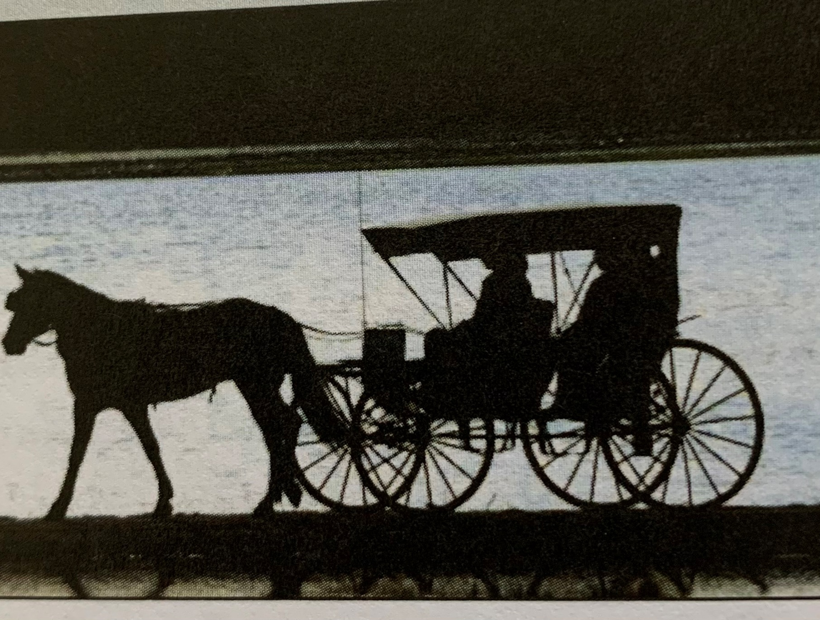
Leaving
Beloeil
Melodie and Eulalie left quietly through the kitchen and back door
of the rectory to get
into the carriage.
Father Theophile, her brother was ill in his room.

Slide 17
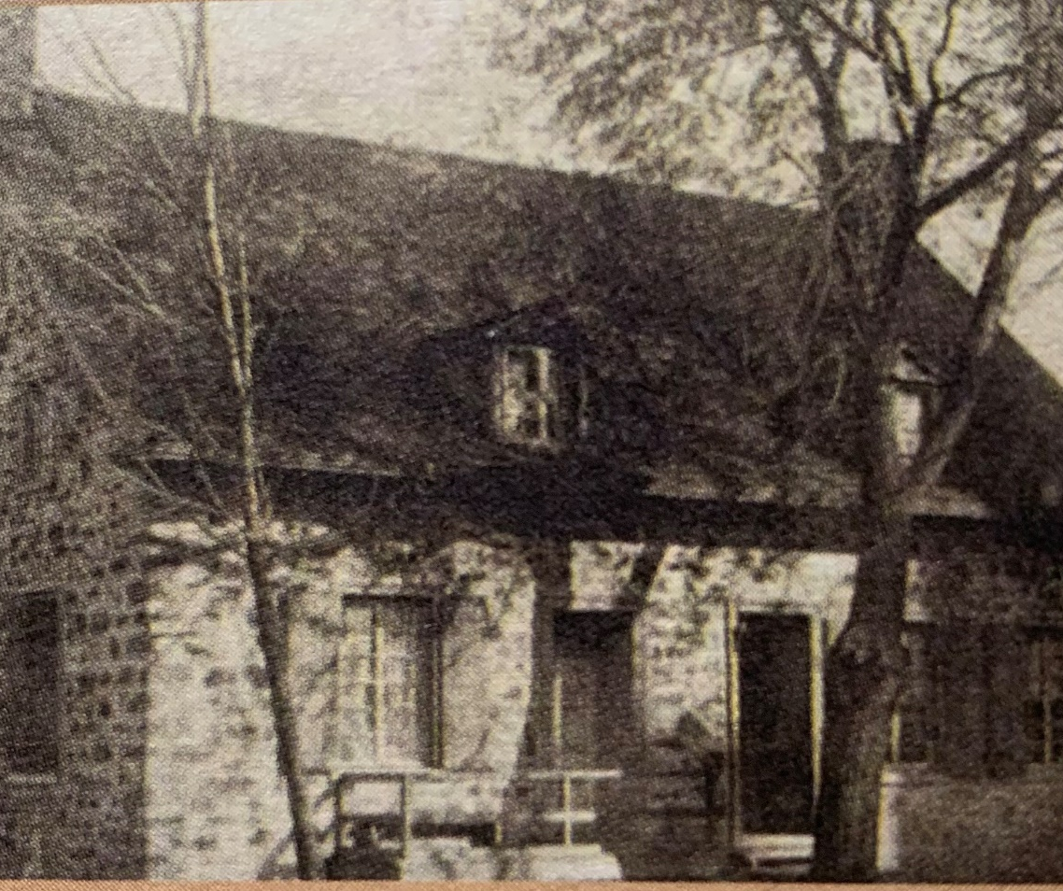
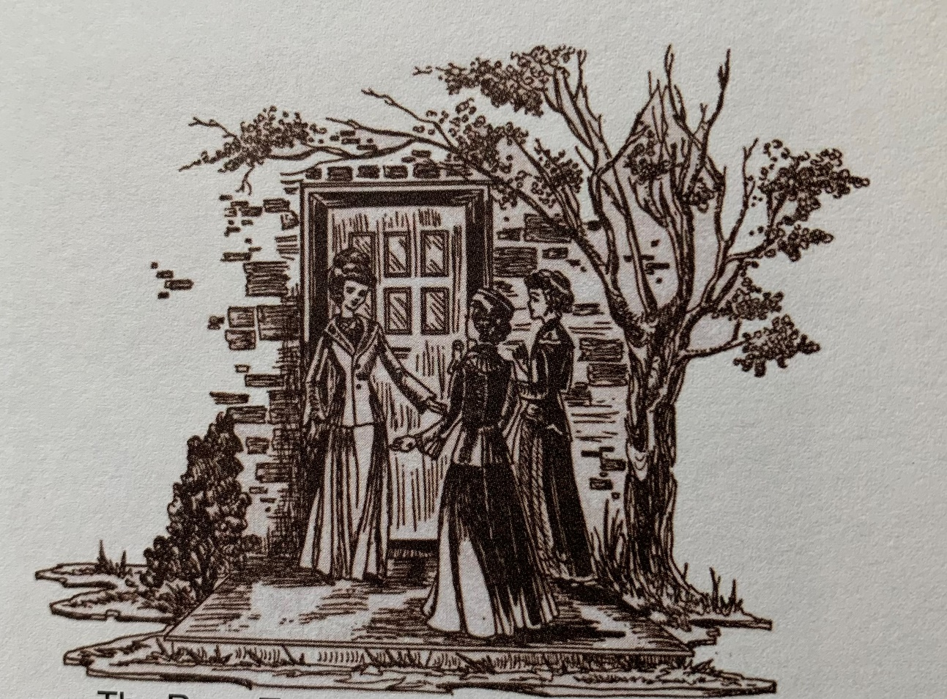
Arrival in Longueuil

Slide 18
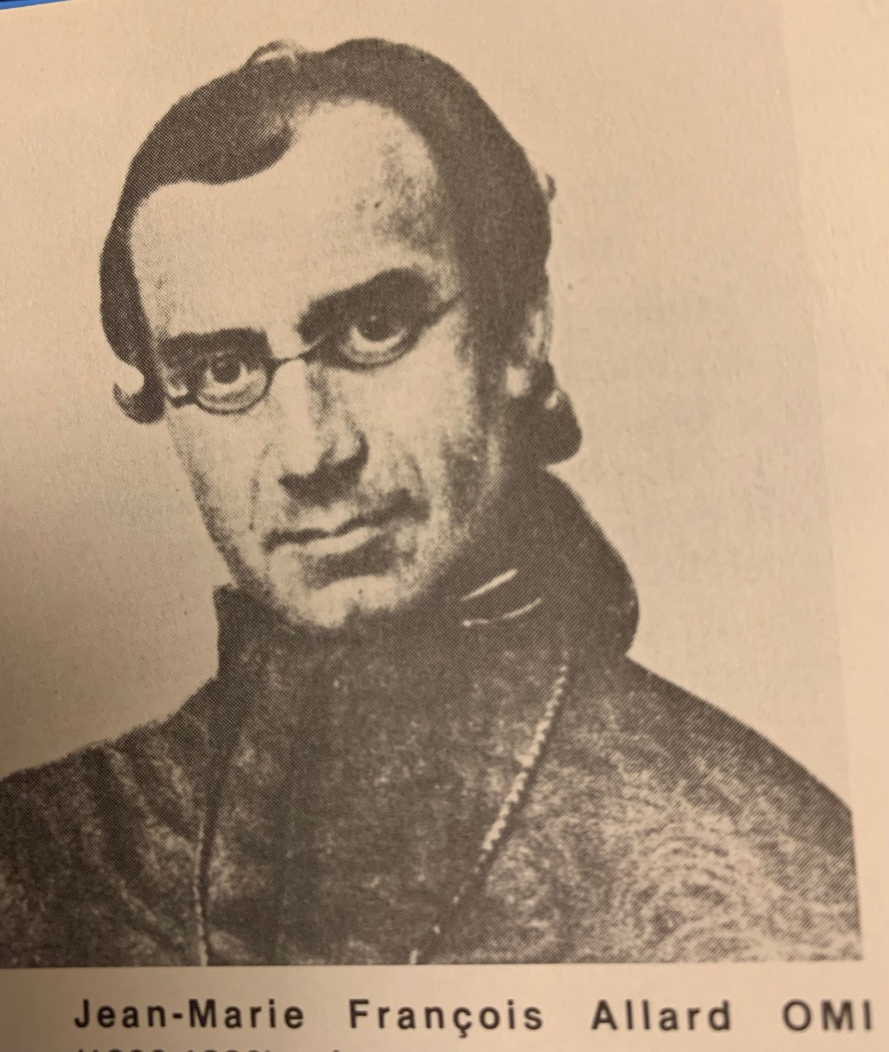
Father Allard
Novice master
Teacher of pedagogy
The school year had already started when Melodie and Eulalie arrived in Longueuil. The students were given a vacation and Father Allard OMI gave a retreat and
On the 1st of November the three started their postulate and were guided in preparing their classes

Slide 19
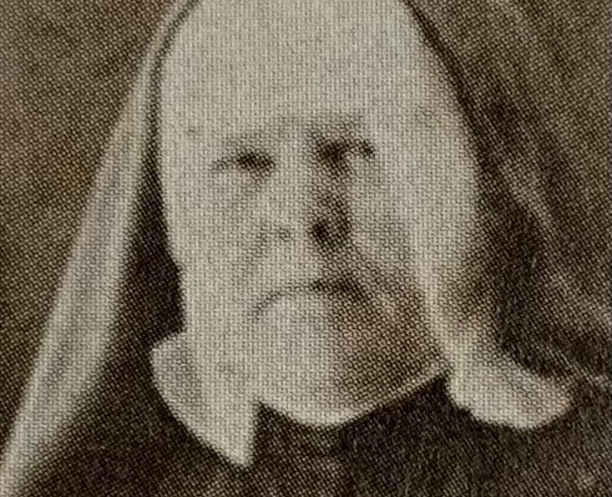
November 15th, 1843 Salomé Martin (to be Teresa of Jesus) an experienced teacher, arrived along with other recruits.
In January 1844, the group had grown to 8 members

Slide 20
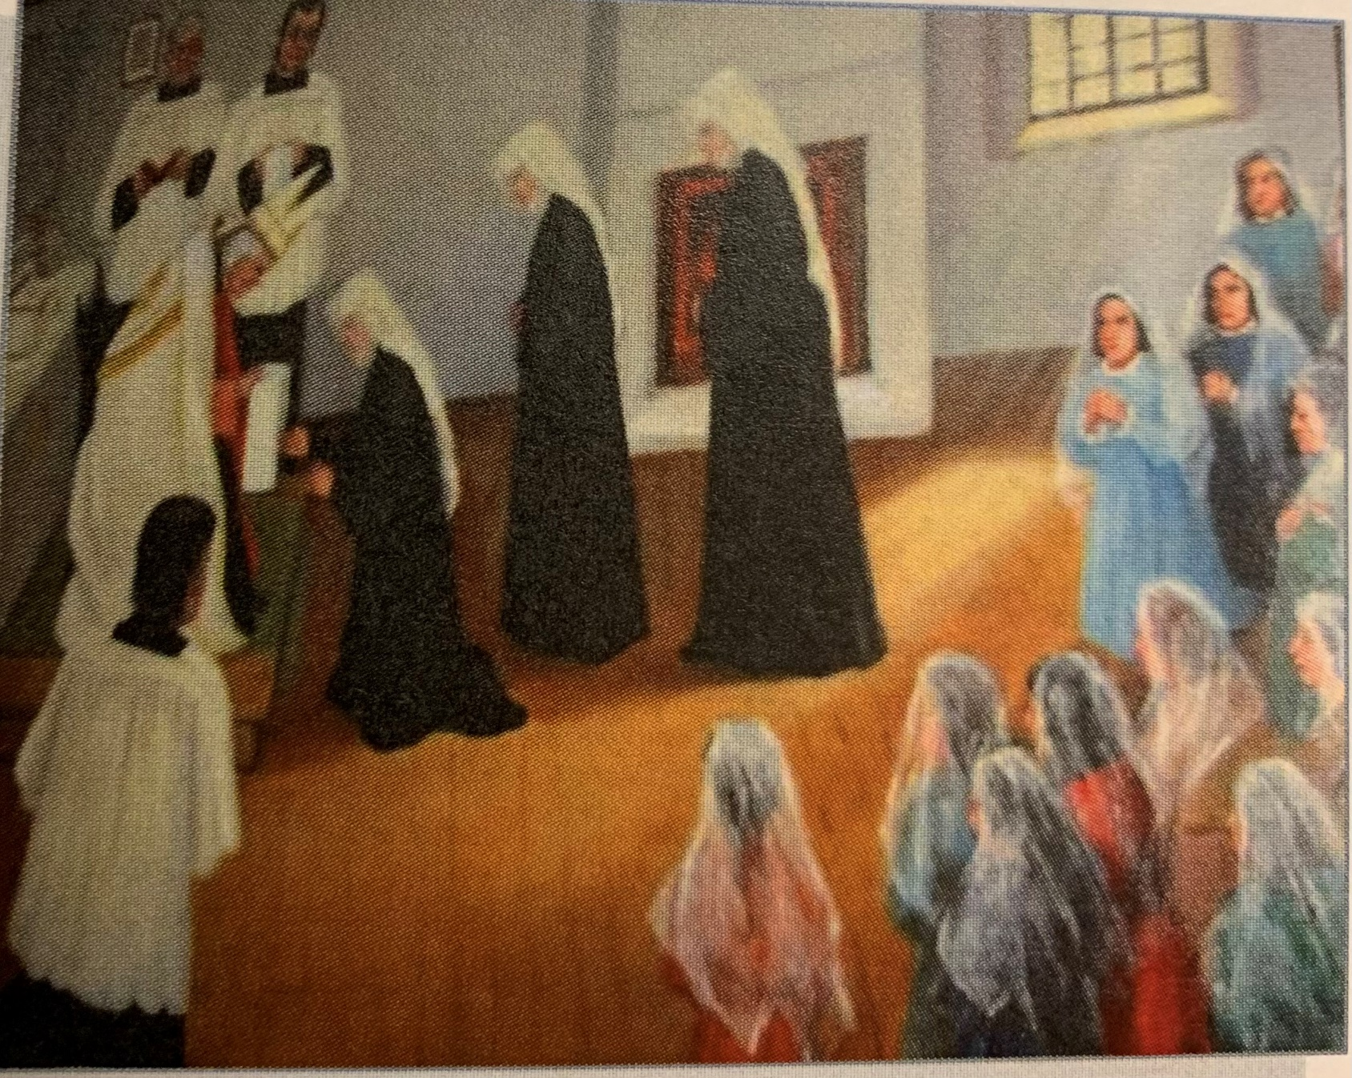
February 28th the three foundresses received the Holy Habit and became novices and received their religious names.
Marie Agnes: in charge of the management of the house, Marie Madelaine in charge of the school, Marie-Rose: porter. In this humble position she remained the soul and leader of the group
(Photo of the painting of the ceremony)

Slide 21
To Sister Saint Cecile, Religious of the Congregation of Notre Dame I
My dear Sister, Longueuil, March 11, 1844
I thank you for the kindness that makes you solicitous for me. It is true that to speak to me as you do, you have only to listen to what your sisterly heart tells you. Now we have something more than the language of nature; we are sisters by a double title. You have experienced what one feels in a family on the occasion of a birth, and ever increasing joy, the joy that I myself am now experiencing. I am a bit upset because of your having written to me first. However, I hope you will excuse my silence. The deep solitude of the novitiate will give you the reason for it.
I am clothed with the holy habit of a religious and I have been given the name of Marie Rose; may I be a rose of pleasing perfume to Jesus Christ. You must assist me by your prayers to fulfill the obligations imposed by this mysterious name.
. . . . . . . .
I count on the help of your prayers. Walking on the same pathway, let us help each other to surmount the difficulties that arise. With this in mind, I shall always be,
Very lovingly yours,
Sister Marie Rose

Slide 22
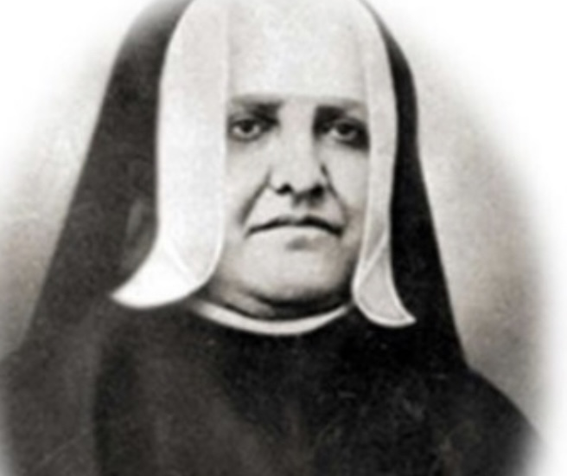
March 1844, Hedwidge Davignon arrived.

Slide 23
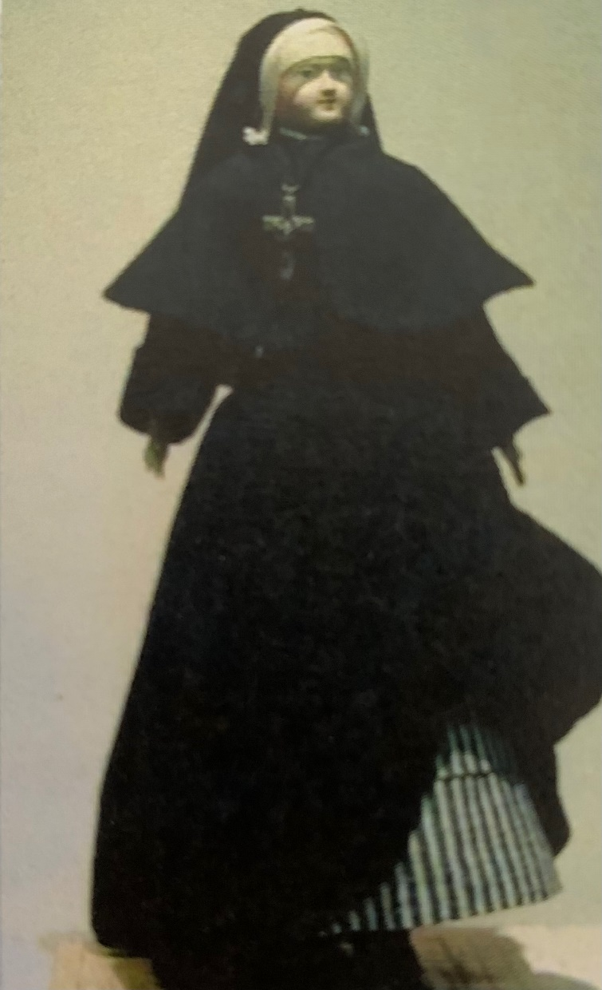
August 8, The arrival from France of the book of Constitutions and a doll dressed in the habit.

Slide 24
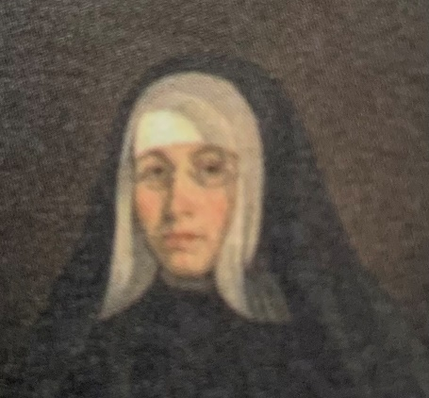
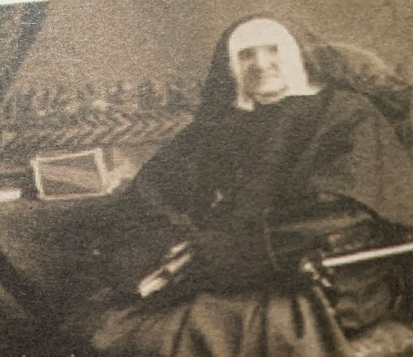
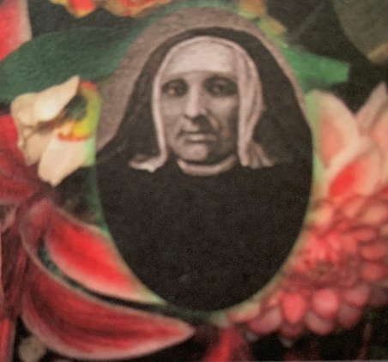
12. December 8th, 1844: first profession in the parish church at the Eucharist
13. Marie Rose is named superior, mistress of novices and general treasurer. She was to be called "mother".
Sister Marie Madeleine was assistant and directress of the boarding school.
Sister Marie Agnes had charge of the upkeep of the house.
The community now had ecclesiastical approval. Mother Marie Rose, in early January of 1845 would request the legal incorporation of the Institute.

Slide 25
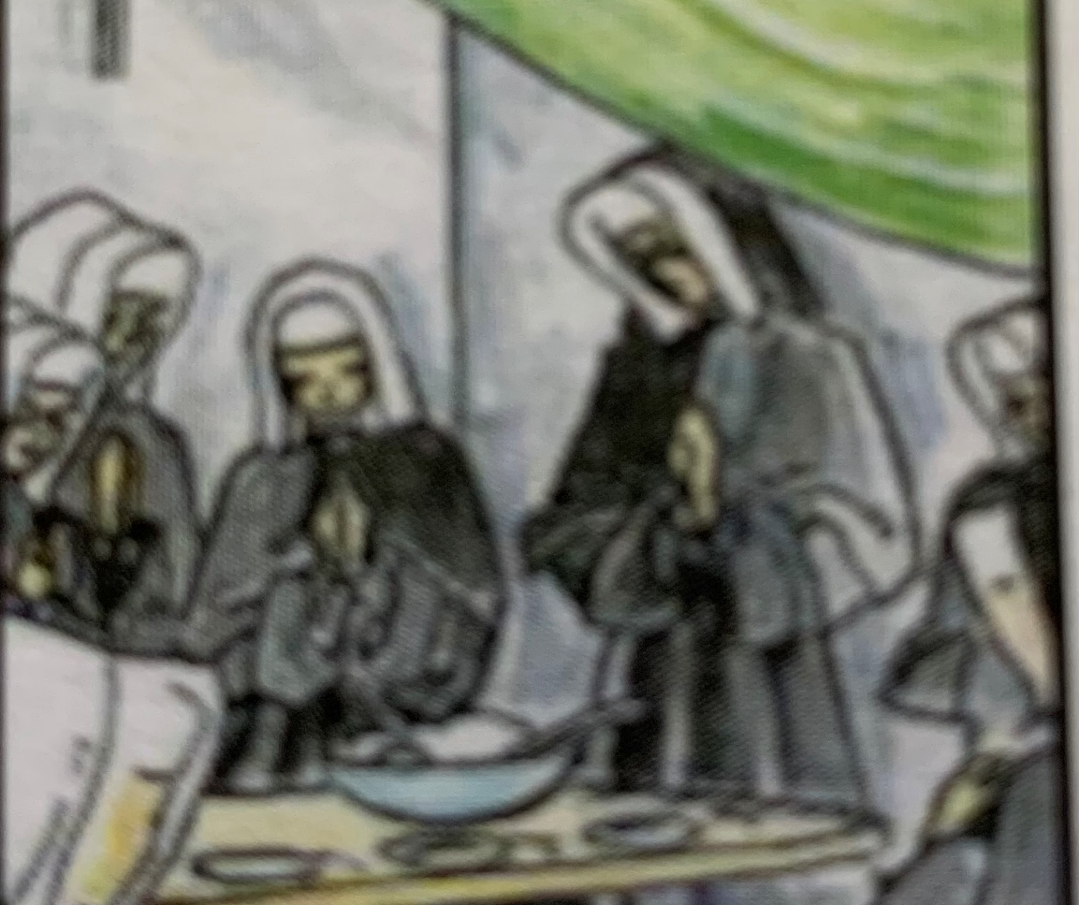
On August 15, 1846, the first five sisters made their final profession. At this time a fourth vow was added: "to dedicate oneself to the education of young persons"

Slide 26
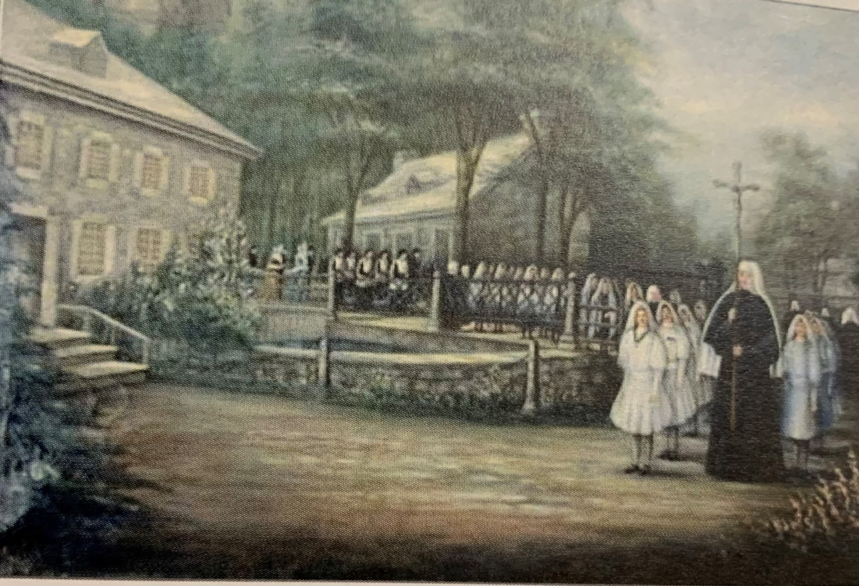
June 1844. Evidence that the convent is too small for all the recruits and Students: the parish buys a hotel converts it into a school and donates to the sisters.
Procession to the 1st convent-school

Slide 27
Constitutions on "Called to serve"
John 20:21 "Like our Creator sent me, I am sending you."
Ephesians 4:11-13 ".. So that the saints together make a unity in the convergence of the work of service, building up the body of Christ
Isaias 61:1-2 "The Spirit of God is upon me....has sent me..."
By her free and faithful commitment, each sister contributes to the actualization of the community charism in bringing her particular gifts.
The convergence of these personal and communal responses intensifies our apostolic vitality.

Slide 28
Education in the faith demands of us active involvement in the promotion of justice.
In this spirit and according to the teachings of the church, our educational endeavors have a special concern for the poor and disadvantaged.
We are challenged by the Gospel
and by the needs of society
to unite our efforts
with those around us
to attain for all people conditions of life
more equitable
and more worthy of human dignity
As individuals and as a Congregation we
give priority to forms of education
that are most closely related
to education in the faith:
  witnessing to the faith,
  preparing for the initial gift of faith,
  deepening the faith.

Slide 29
Acts of the chapter 2001
“We Are Called to Be Women of the Church”
Faithful to the transforming Spirit in our Church and world we seek
  unity in diversity
  dialogue in times of difference,
  healing and reconciliation in pain and brokenness
Within the institutional Church we are experiencing tensions:
  exclusion of women and others who are marginalized within the church;
  lack of respect, understanding, and dialogue;
  alienation of persons and groups.

Slide 30
Chapter acts cont'd
  signs of hope:
  places and models where partnerships are working;
  openness and understanding by some in Church authority experiences of solidarity across religious congregations in naming, claiming, and proclaiming their identity and truth
These experiences tell us:
  There is a need to develop relationships within the church that foster respect, mutuality, and justice.
  As women religious we are called to be a prophetic witness within the Church
  In solidarity with others we need to participate in the renewal of the Church.
We ask one another:
  How do differing images of Church result in tensions?
  How do we stay in relationship with the Church even in times when tensions are high?
  What creative steps can we take individually and together to bring forth new life and energy within the Church?

Slide 31
How are we serving now?
Leadership
Caring for one another in Community
Call for systemic change
Changing our lifestyle for the benefit of the common good
Peace and climate education
Prayer groups
…. name more....

Slide 32
Questions for the next session on new life through suffering
What new life emerged from the sufferings, losses and difficulties on your life journey?

Slide 33
Closing prayer
Closing song: https://youtu.be/Q2vYFN1YNIk

