Slide 1

Prayer in
Our Life
Associate Formation
Session Three

Slide 2
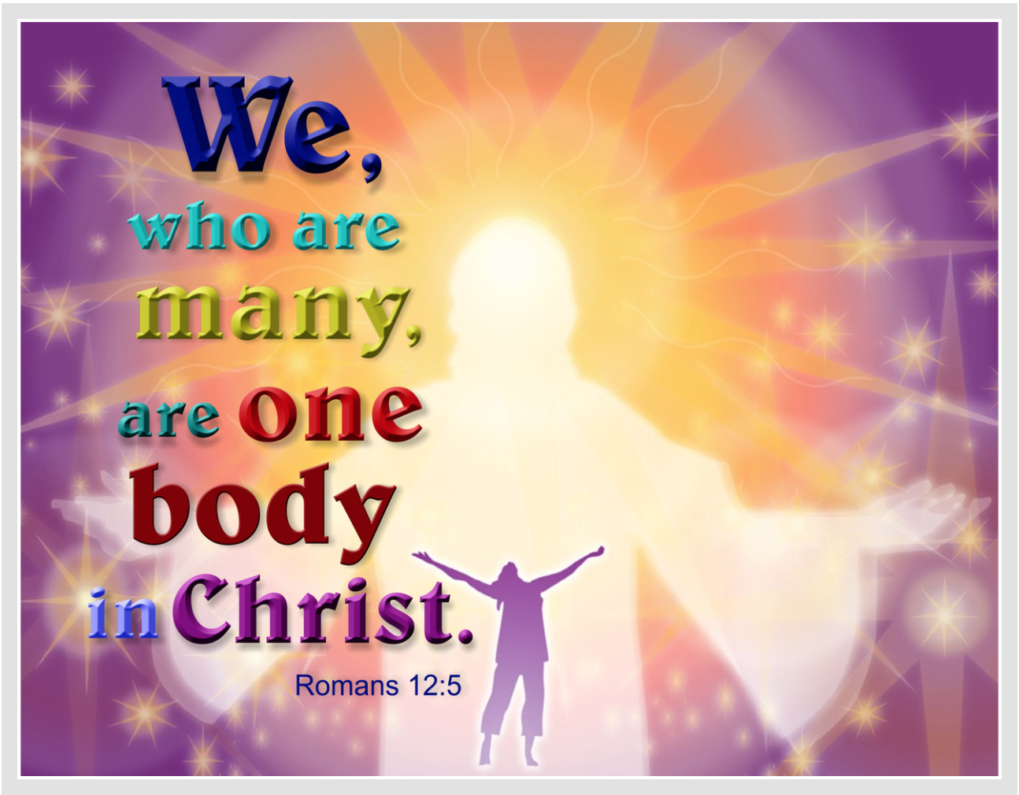
Opening Song: Come Be in My Heart, Sarah Thompson https://youtu.be/gwxldz6oH2w

Slide 3
Questions for the Small Groups
Describe the different steps in your life of prayer.
How did you pray as a child? Adolescent, in your youth?
How is your prayer life going at this time?
What is your favorite way of praying?

Slide 4
Forms of Passive Prayer
Prayer in silence
Prayer using a mantra or centering on an object (candle)
Prayer using a sacred word for as long as needed
Making space in daily life for God's active presence within and without (the contemplative life)

Slide 5
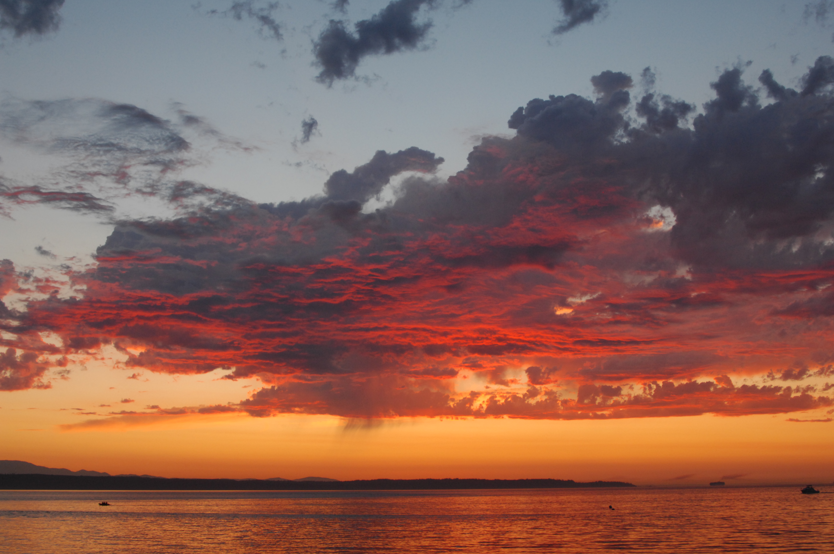
Passive Prayer: Let Go of the Shore, Karen Druker https://youtu.be/HwWFZk4DI-w
This Photo by Unknown author is licensed under CC BY.

Slide 6
Various forms of active prayer
Active meditation using imagination and dialogue
Liturgical prayer including morning and evening prayer
Lectio Divina: reading, reflection in silence, sacred sharing
Spontaneous group prayer with sharing over a spiritual text
Contemplation of nature
Contemplative walking
Welcoming prayer: focusing, welcoming, letting go and handing over
Connecting to the presence of God in daily life

Slide 7
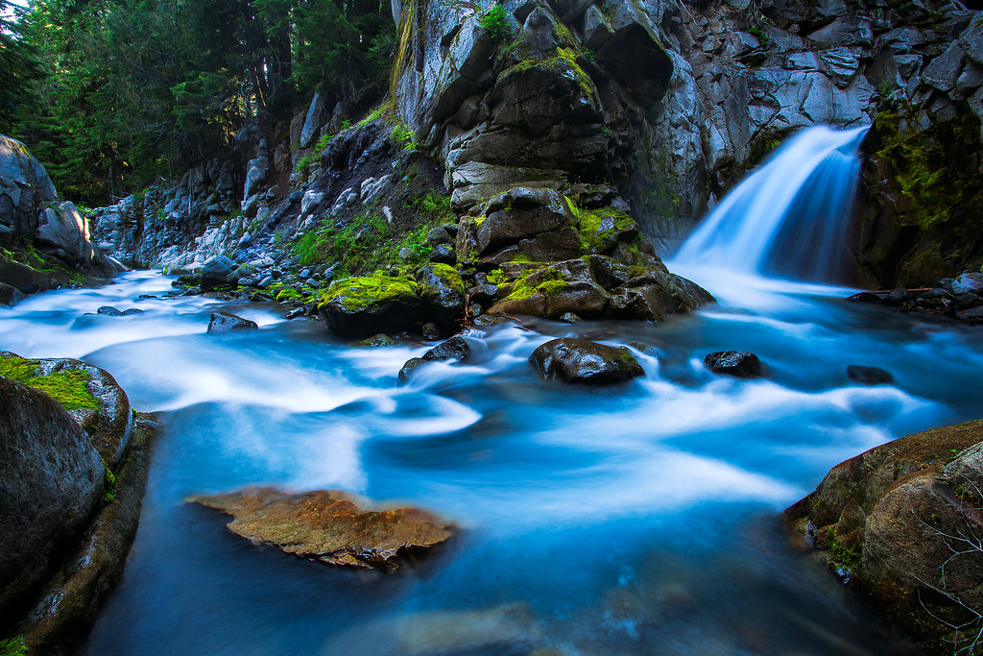
Active Prayer: Here in This Place https://youtu.be/cVWY9ourooI
This Photo by Unknown author is licensed under CC BY-NC.

Slide 8
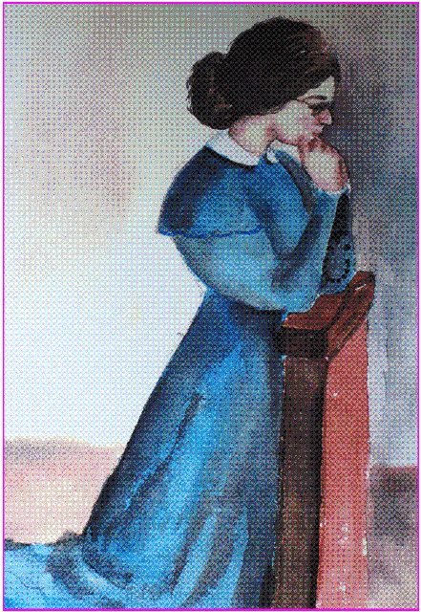
The Life of Prayer of Eulalie Durocher

Slide 9
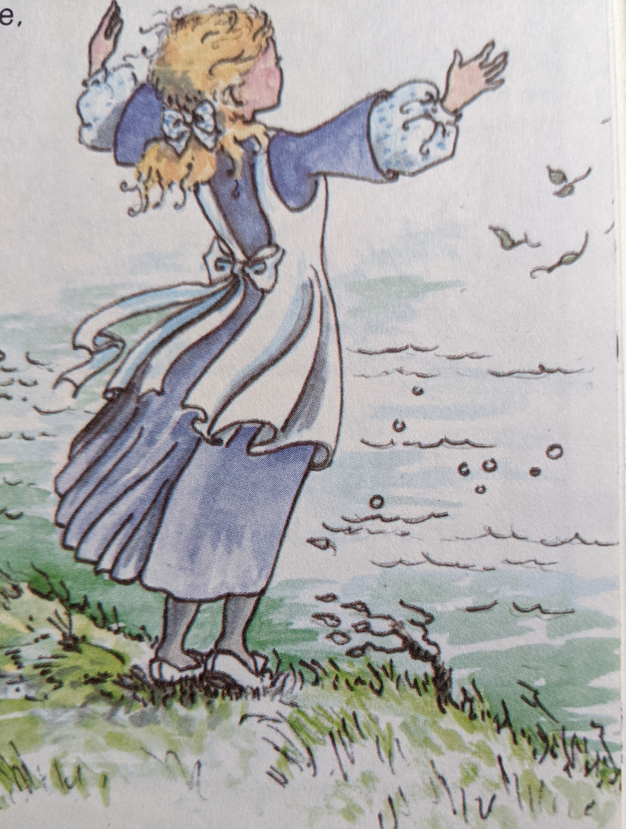
Childhood
Communion with Nature
Family Prayer
Sacraments

Slide 10
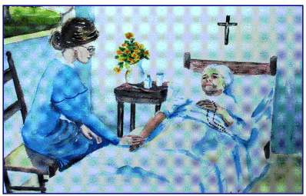
Young Woman at Home and Visits in the Parish

Slide 11
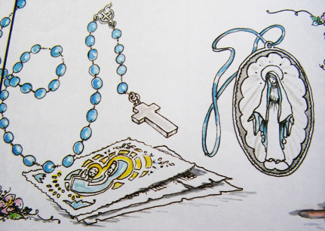
Assistant in the Parish of Beloeuil, Prayer Leader

Slide 12
Importance of Prayer in the Daily Schedule of the Congregation
Oral prayers in the morning in chapel followed by silent active meditation
Mass at the parish church across the street, then in their own chapel
Silent prayer after mass, mid-prayer before lunch
Spiritual reading in the community room before supper
Oral evening prayer each night
Benediction of the Blessed Sacrament every Sunday evening in church
Monthly day retreat +December 31st
triduum before the feast of the Immaculate Conception, and on Annual 8-day retreat, Jesuits and Oblates alternating each year, 30-day retreat at least once in our life *used to be done just before final vows.

Slide 13
Her Favorite Spot when Praying in the Chapel

Slide 14
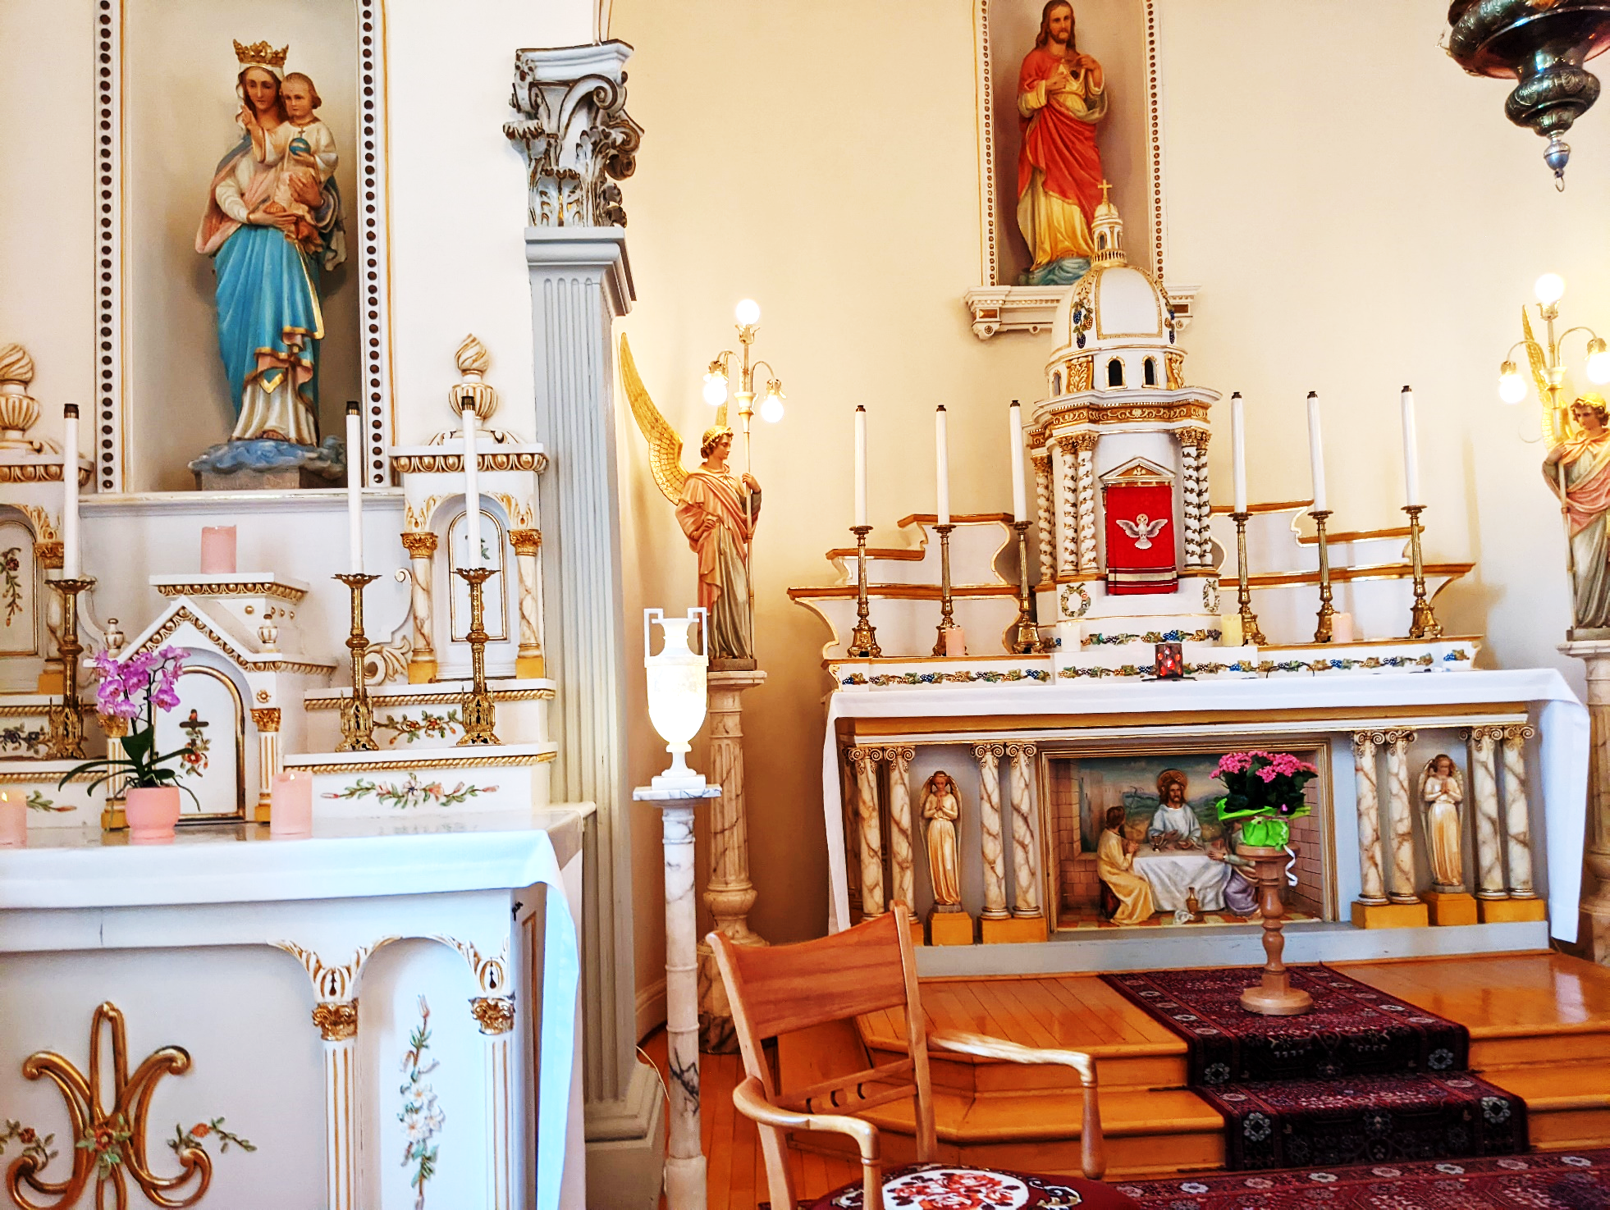
View from Her Spot in Chapel

Slide 15
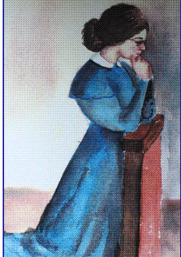
Letter to
Her Sister, Mother Saint Cecil, CND
Longueuil, March 11, 1844
My dear sister,
At the time I was planning to invite you to my religious profession, the painful news of your illness reached me and filled me with sadness. You know what a great satisfaction it would have been for me to have seen you here. You have already had the great happiness of doing what I am about to do. As I take this my great step, your very presence would, as it were, have been like a helping hand. God has other plans.
……
I am counting on your prayers and those of your Reverend Mother and Sisters to whom I beg you to present my respects.
In a sweet hope for your complete cure, I beg you to accept my most loving greetings as I remain
Your very loving sister,
Sister Marie Rose

Slide 16
Letter to Her Brother Father Flavian Durocher, Oblate Novice at Saguenay, Quebec.
Longueuil, December, 1844
My dear Brother,
  Allow me to distract you a bit and tell you of the happiness of my religious profession. It was on the feast of the Immaculate Conception that this good, kind, Mother willed to accomplish the desires I had so long cherished. I shall not speak to you about the ceremony because I do not think that is what will interest you most. God has been infinitely good to me and full of mercy...The responsibility that weighs on me is great. I feel it more and more each day, but who am I to complain? . . .
  God has led me. I live in peace with my Sisters in the midst of my numerous occupations.
  Beg Mary, our tender Mother, to obtain for me above all the grace of being a good religious so that I may follow the pathway God has marked out for me and along it, lead all those for whom I am responsible. We should be only too happy if some day we were found worthy to go and share your difficulties.
  Please express our deep respect to Father Honorat and assure him we are still filled with gratitude for the great trouble he took for our sake. If God hears our prayers, He will scatter rich blessings on all your undertakings. … I have heard from the family. All are well. It seems that Father Eusebe has many spiritual consolations at his mission: this makes up for what he lacks materially. I would love to be writing to you as a vowed religious because I wish for you the happiness I am enjoying.
  In the Sacred Hearts of Jesus and Mary, I remain,
  Your very loving sister,
  Sister Marie Rose

Slide 17
Letter to Her Brother Fr. Theophile Durocher, Pastor of Beloeuil
Longueuil, February, 1847
Dear Brother,
You know that one is never satisfied with what one has. Our new chapel is so devoid of pious objects, above all of pictures, that one does not know where to fix one’s eyes.
We have the picture of the blessed Virgin on one side and on the other that of St. Joseph. I thought that in the center it would be very nice to have the Sacred Heart you have in your little sacristy chapel. It would be all the more fitting since we belong to the Confraternity of the Sacred Heart. If you cannot give it to us, I hope you will be able to lend it to us at least until we can get another one. ….
Please extend best wishes to Papa, to Mr. Allaire, and receive for yourself my respectful greetings and believe me always united with you in the Sacred Hearts of Jesus and Mary,
Your devoted and affectionate,
Sister Marie-Rose

Slide 18
Letter to Sister M. Claire, Beloeuil Convent
Longueuil, April 27th, 1847
Dear Sister,
I have just received your letter, which pleased me. I understand very well indeed that the period of your absence from us seems a bit long. However, I do not know how long you will remain there; but in the meantime, do your duty well. Do not forget to make your meditation every day and prepare yourself for the great benefits that will come to you later in the day, from this prayer time given to you. In the meantime, I should like to know how you make your meditation, the time you give to it and to your other spiritual exercises. How do you teach catechism, and what amount of time have you to prepare it? How do you enjoy your time with the children? How do you get them to work? Please answer these various questions.
With much love, I am in the Sacred Hearts of Jesus and Mary,
Your devoted and affectionate,
Sister Marie-Rose

Slide 19
SNJM
Constitutions
Contemplation in Action
57 Enabled by the Spirit,
We, like Jesus,
Seek a living relationship with our God
This contemplative dimension
Permeates and transforms our lives.
It is expressed in prayer,
and by an interior attitude
of presence to God in ourselves,
in others, and in events.
58 Contemplation inspires action;
action reflects contemplation.
They are two aspects of a single love.
59 Our life of prayer, rooted in faith,
sustains our hope
and animates our charity.

Slide 20
Private prayer
60 Jesus often withdrew
to be alone with his Father.
So, too, we meet God
each day in prayer.
We spend at least a half-hour
In daily meditation
choosing the time and expression
which best facilitate
our personal prayer.
These privileged moments
of presence to God
renew and strengthen us
for the apostolate.

Slide 21
61 To deepen our relationship with Christ
And to grow in the knowledge
Of his Gospel message,
We set aside adequate time
For spiritual reading
And for prolonged periods of prayer,
Such as days of recollection,
Annual retreats, and other experiences
Which nourish faith.

Slide 22
Chapter Acts 2001
We Are Called to Be Women of Contemplation in Action
Be still and know that I am God. Psalm 46:10
We desire God.
We desire what God desires.
We desire God’s justice, tenderness and communion.
Acts of the 1996 Chapter
Contemplation in action is the creative energy at the heart of our mission.
We reaffirm this profound conviction, remembering that to contemplate is
To be in the presence of God who is passionate about all creation
To be in the presence of the Holy One who is revealed in the faces of all those we encounter, particularly persons who are impoverished and marginalized.

Slide 23
Questions for Next Session in September on Service – Women in the Church
Looking back at your life, how did the call to serve begin?
  A. in your family?
  B. in the church?
  C. in your community?

Slide 24

Closing Prayer and Song
https://youtu.be/T8rCjcmxWPs
The Prayer of Jesus as interpreted
by Miriam Therese Winter
Leader: Let us pray together the prayer of Jesus:
All: Holy One, who is within, around and among us,
We celebrate your many names.
Your Wisdom come.
Your will be done, unfolding from the depths within us,
Each day you give us all we need;
You remind us of our limits, and we let go.
You support us in our power, and we act with courage.
For you are the dwelling place within us,
the empowerment around us,
and the celebration among us, now and forever. Amen

