Slide 1


Slide 2
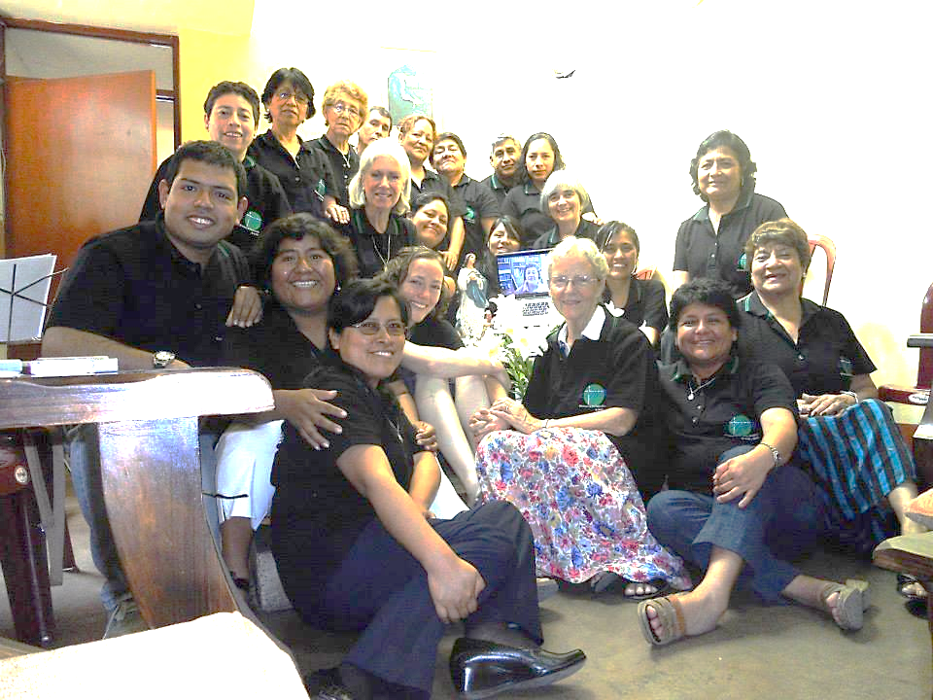
December 8, Isabel Sanchez (laptop) of Nicaragua joins the group
2012, 8 de diciembre Isabel Sanchez de Nicaragua se une al grupo

Slide 3
Education in the Faith
Educación en la fe
Stepping stones in the faith life of Eulalie Durocher
Hitos en la vida de fe de Eulalia Durocher

Slide 4
Questions for the Sharings in the Small Groups
What have been the stepping stones (people, events, experiences) that helped you connect with the God of your life?
How did those stepping stones help you grow in your faith?

Slide 5
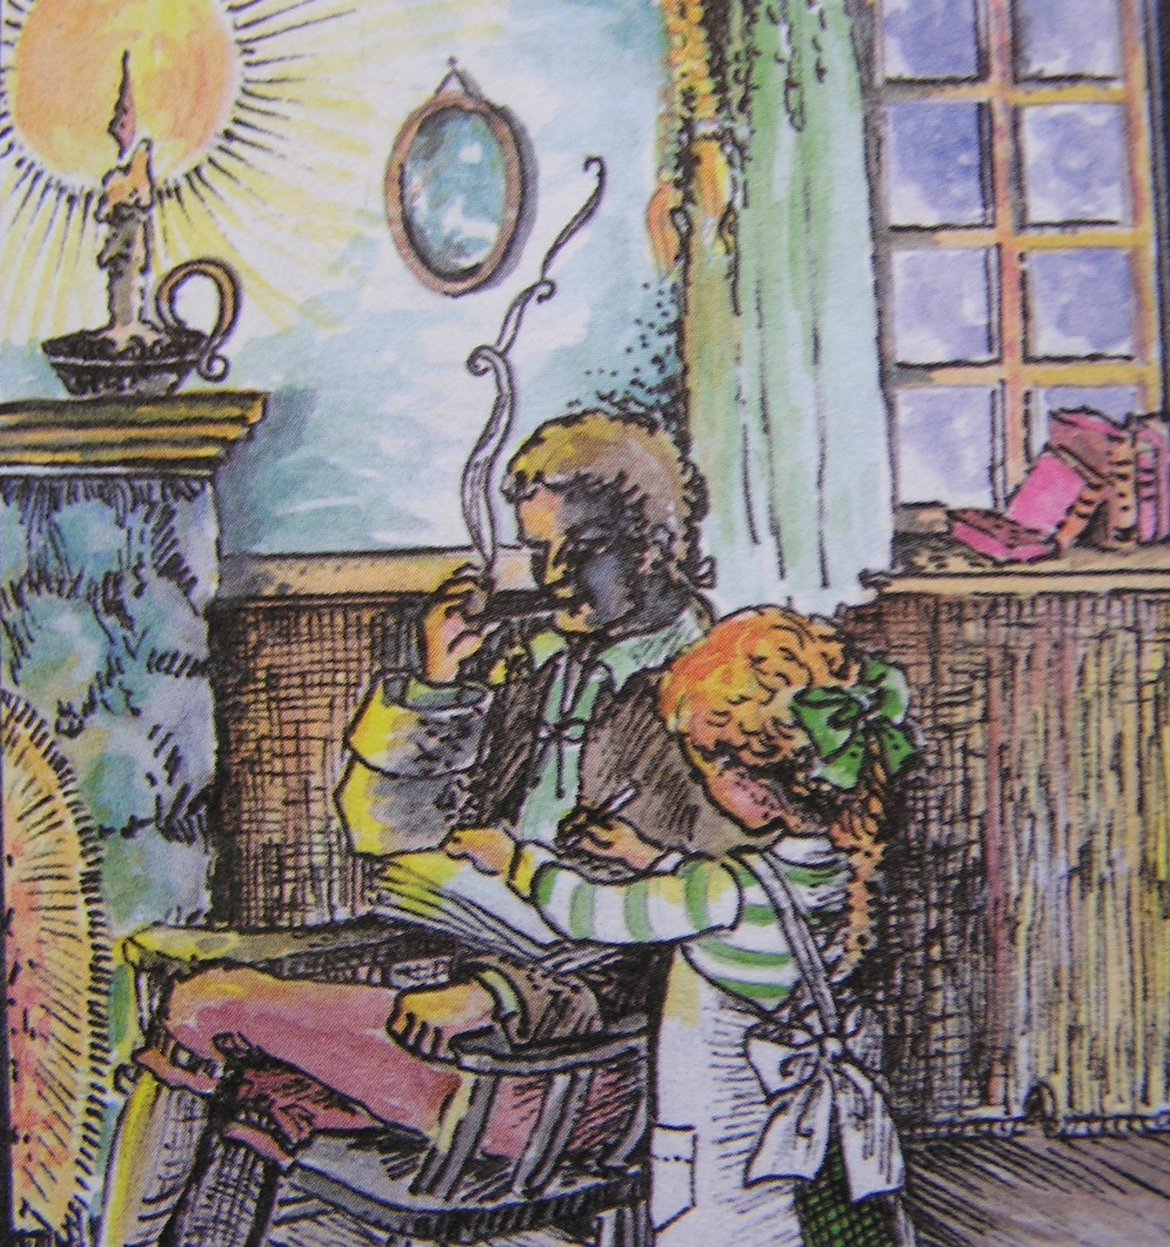
Eulalie’s life…
She was baptized October 6th 1811
Her paternal grandfather taught her to read and write and told stories about the history of Quebec as one who had lived and contributed to it.
He was college educated and wanted to be a priest, but followed his father’s wish that he marry and take the family farm.

Slide 6
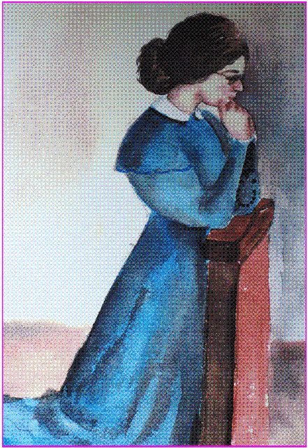
Her mother was also educated by the Ursulines of Quebec city and had wanted to join them but couldn’t due to ill health.
She walked with her to the church of St. Antoine where they lit a candle and prayed.

Slide 7
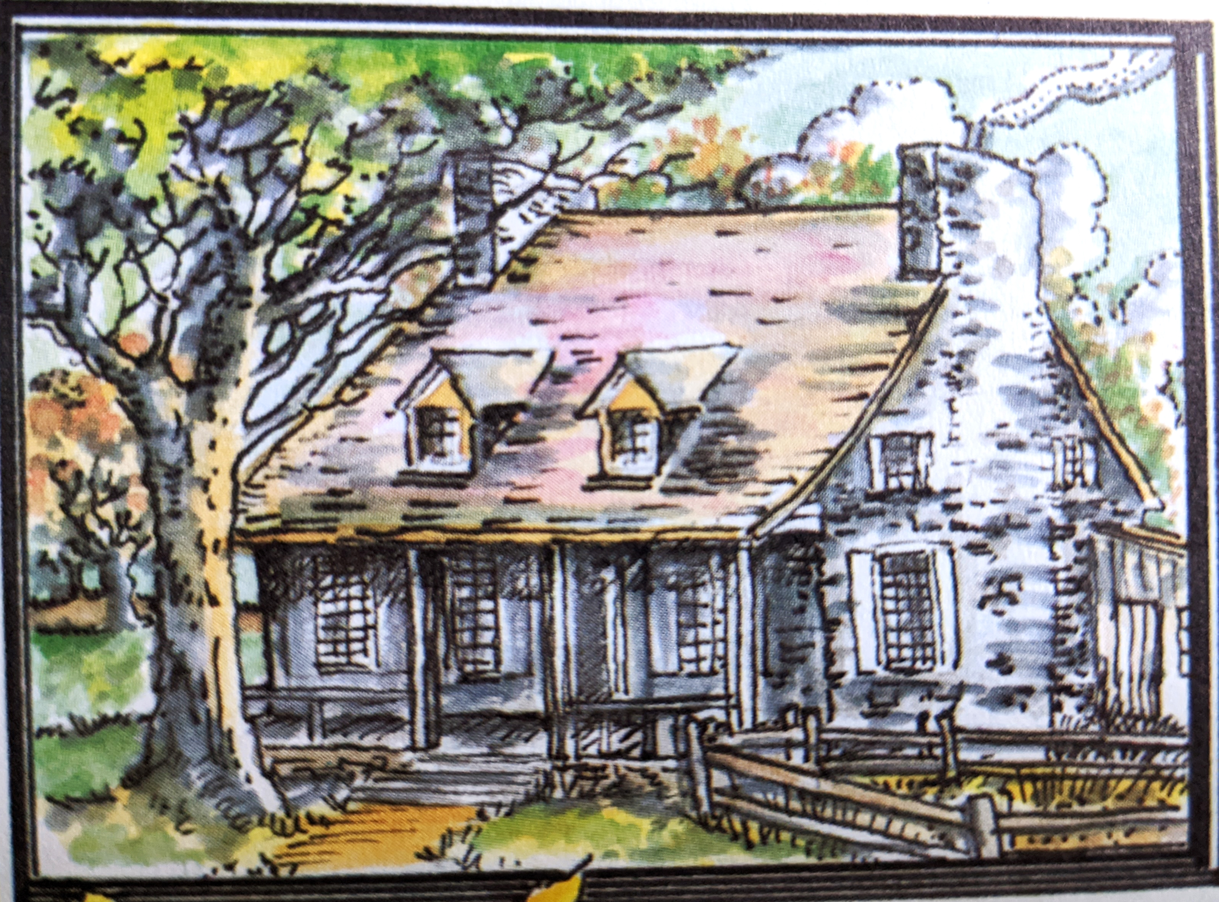
The family farm and home was on the edge of the Richelieu river in St. Antoine, Quebec, Canada.
She was sent to boarding school with the Sisters of the Congregation of Notre Dame in St. Denis accross the river.
She made her first communion and confirmation on or about June 26, 1823

Slide 8
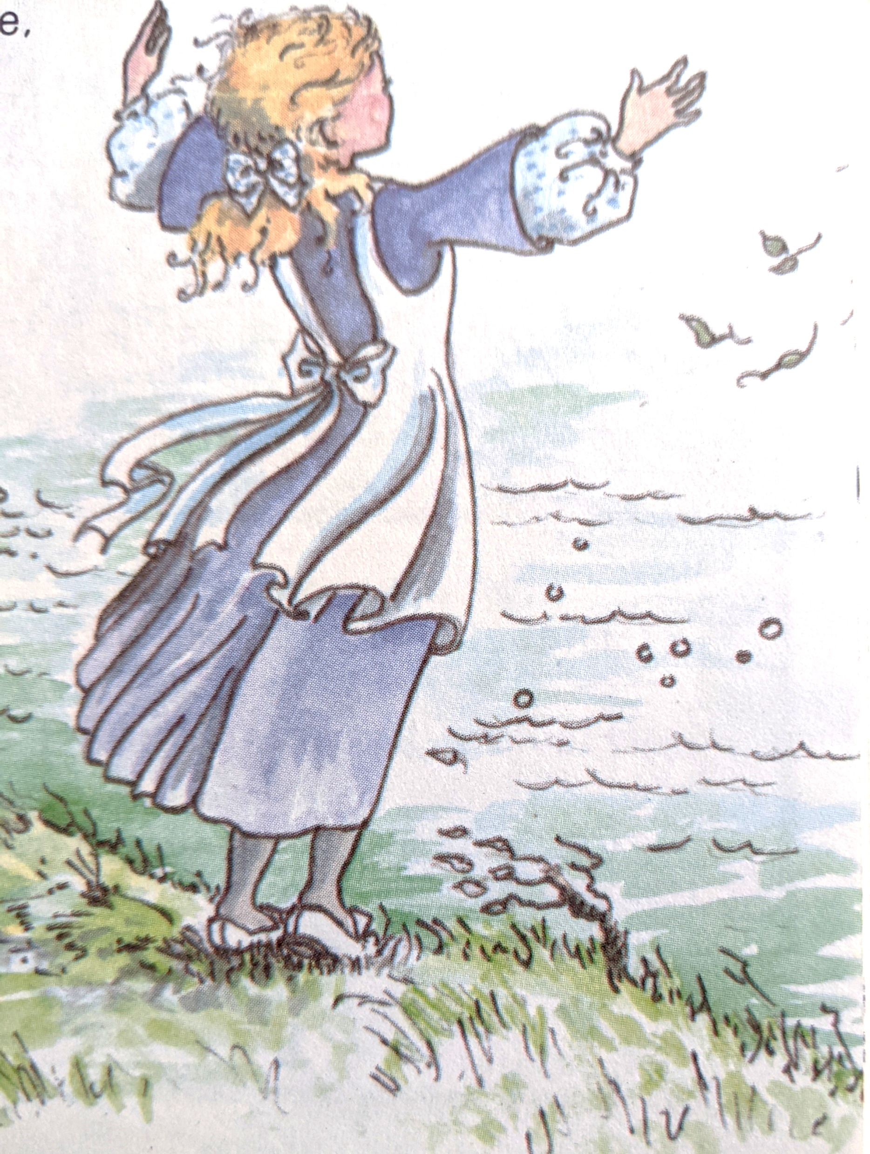
She lived in constant contact with Mother Nature.
Vivía en contacto constante con la Madre Tierra.

Slide 9
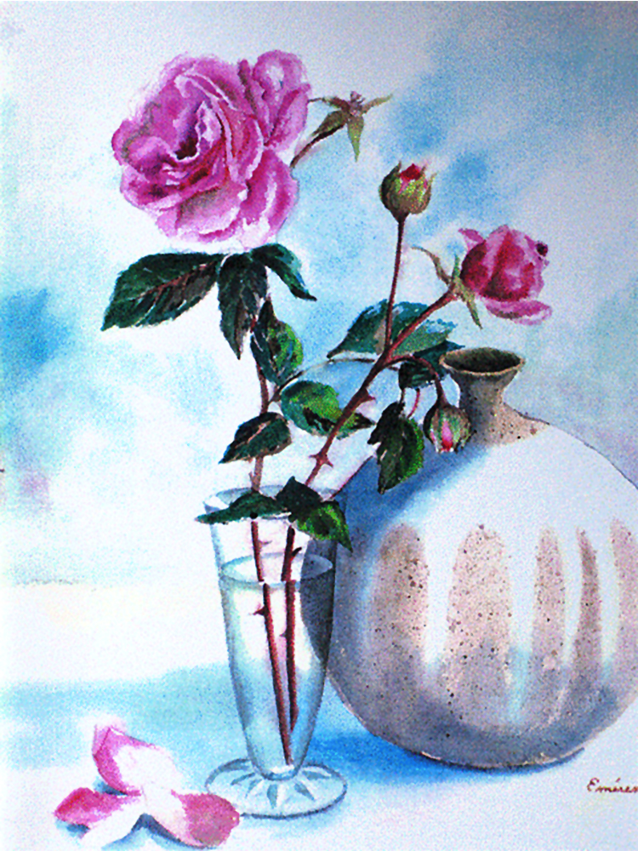
At 15, she went to boarding school in Montreal with the CND’s but ill health caused her to return home.
Back home her education continued in the arts, crafts and home management making her an excellent homemaker and hostess.

Slide 10
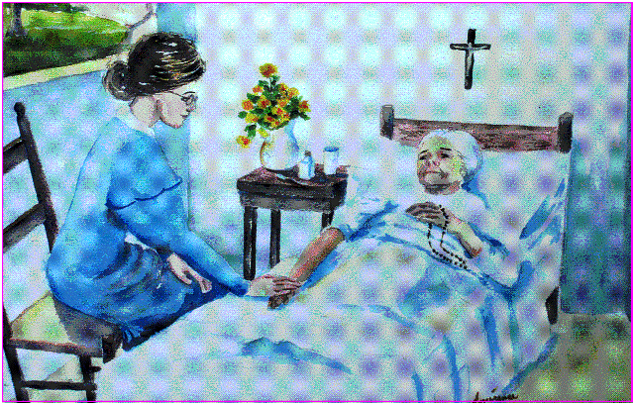
The Death of Her Mother
1830: Her mother died in January when Eulalie was 18. Remained the only woman in the house. (two of her sisters had entered the convent, another sister married)

Slide 11
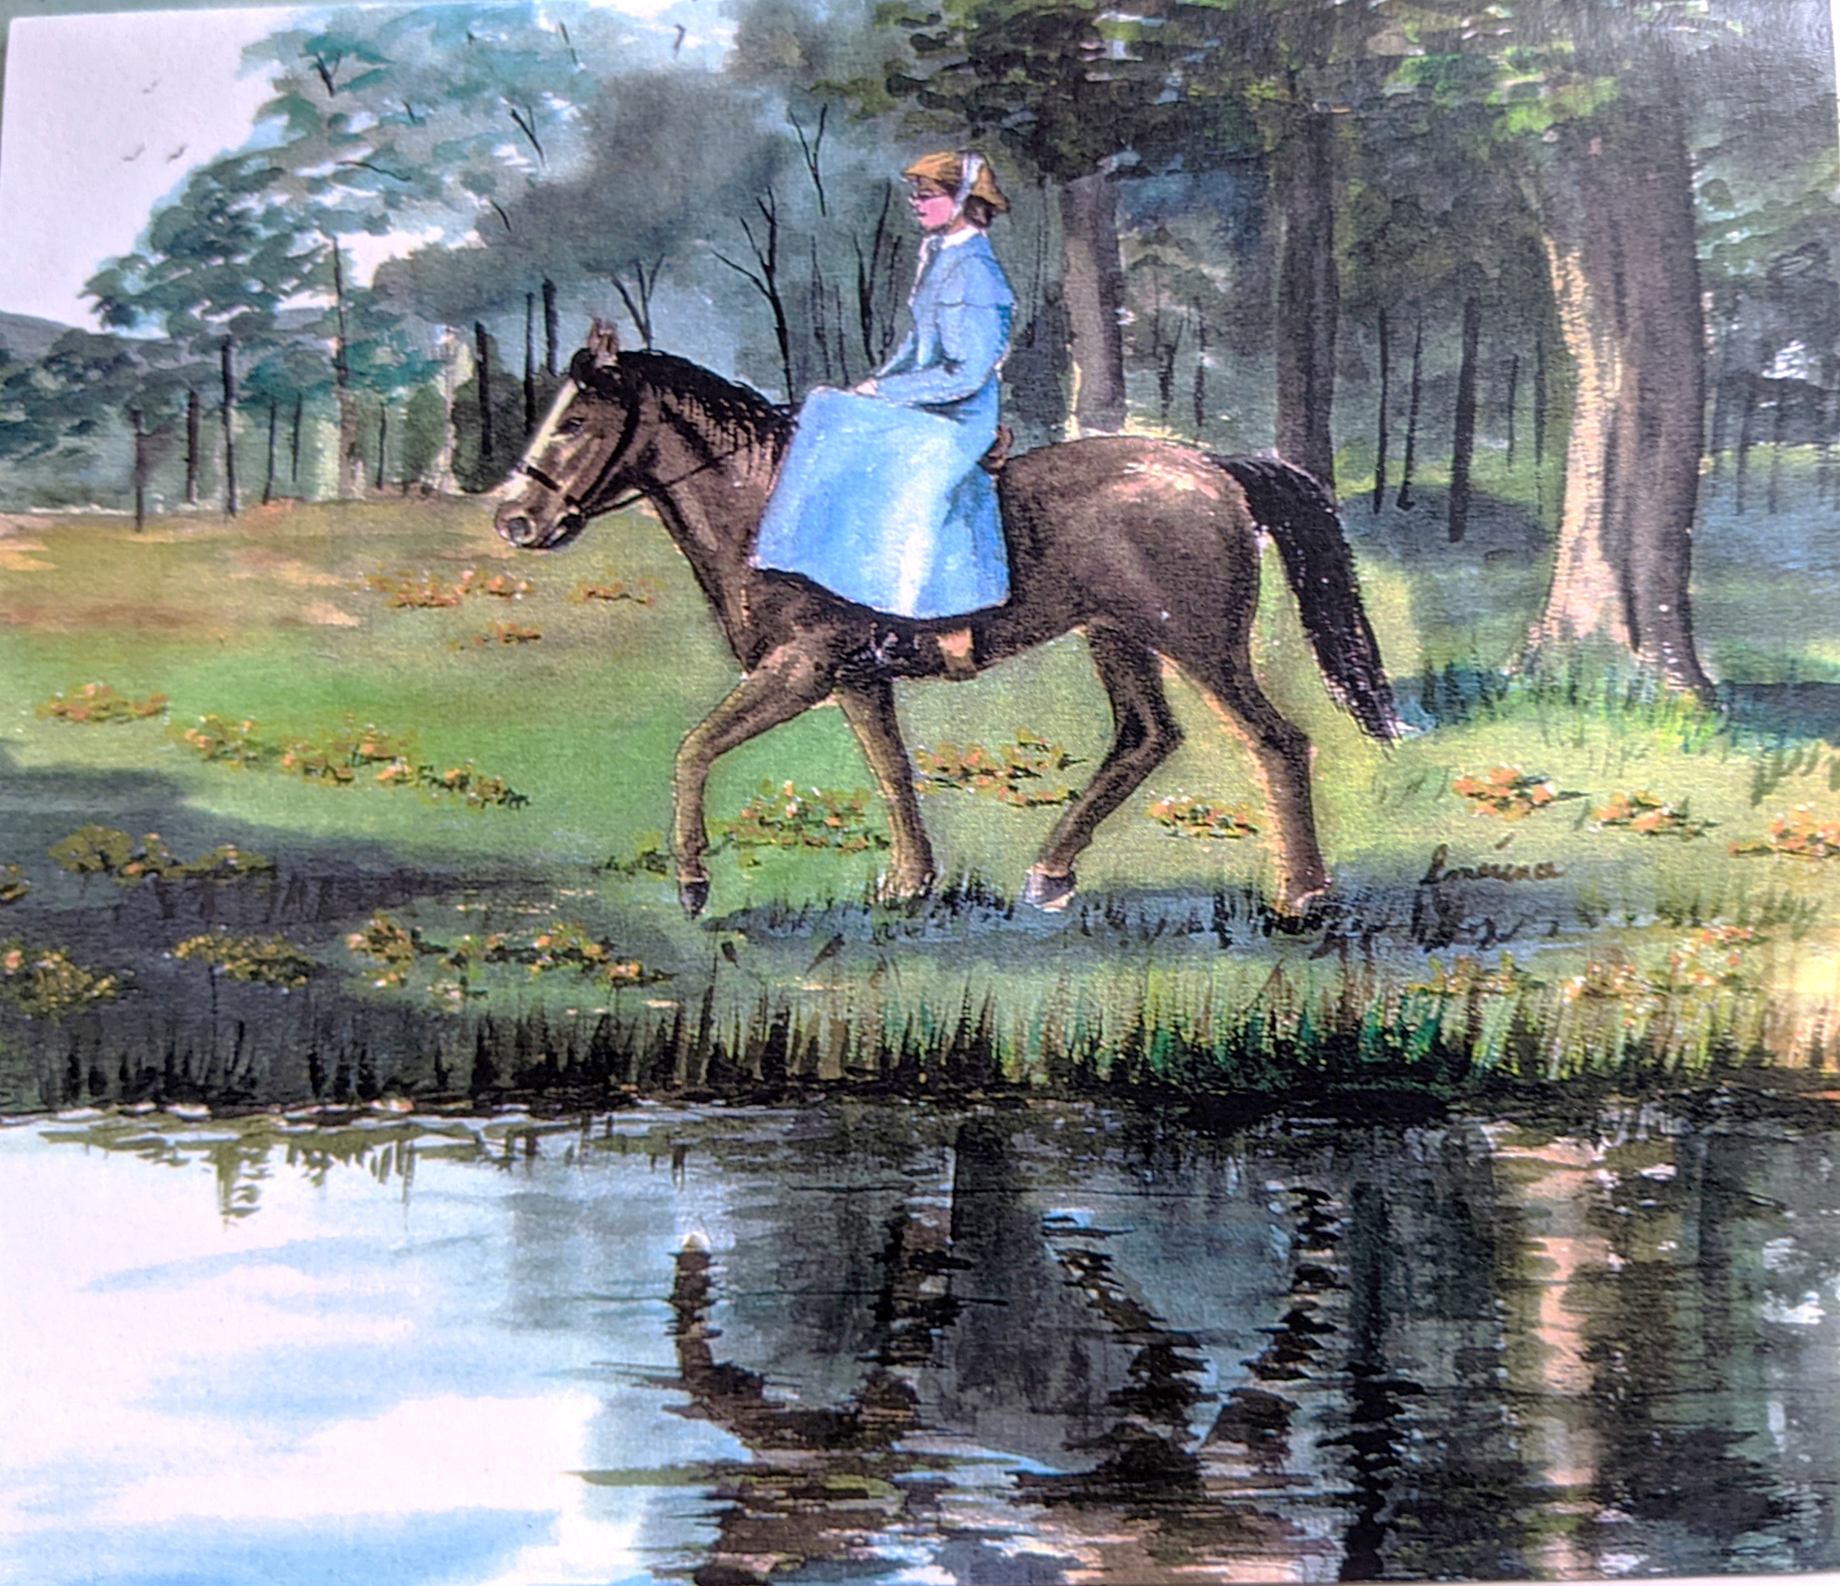
Eulalie’s Responsabilities
Las responsabilidades de Eulalie
1829: Household and parish responsibilities.
She visited parishioners and went to church on horseback.
Went to join her brother Theophile, named to St. Benoit north of Montreal after the pastor died.
He needed her to help the bereft two housekeepers and niece of the pastor.
This prepared her for her years in Beloeil where she worked along with her brother for 12 years

Slide 12
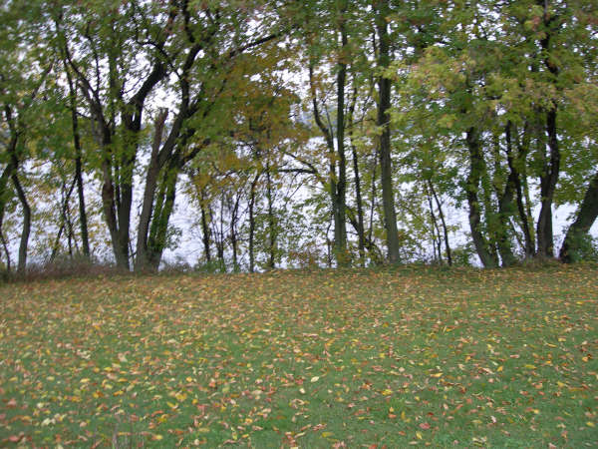
The View of the River from Her House
La vista del río desde su casa

Slide 13
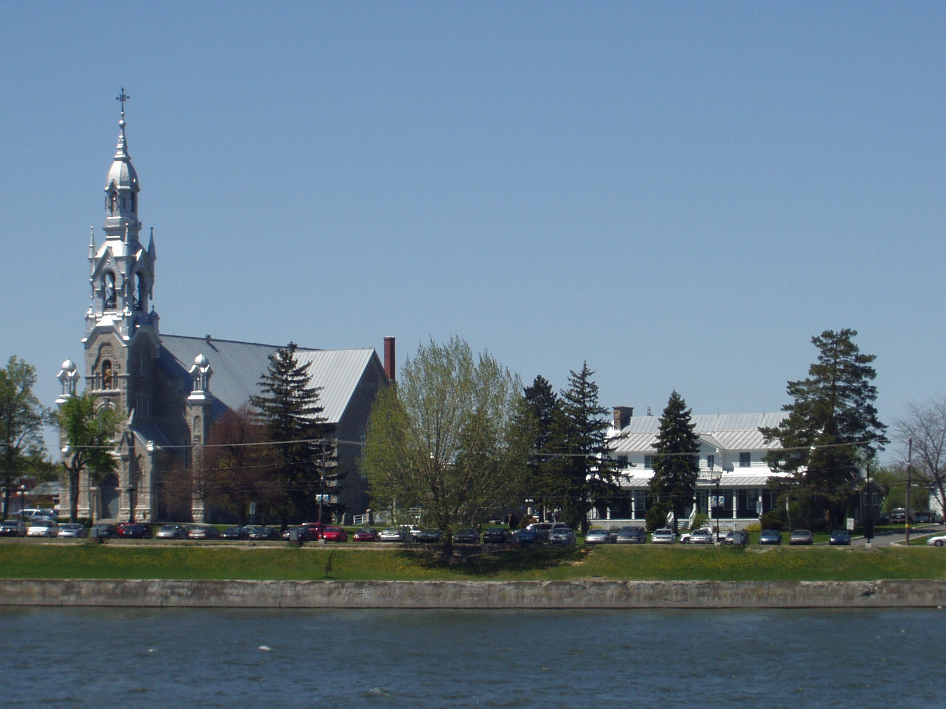
Saint Matthew Church in Beloeuil
El Templo de San Mateo

Slide 14
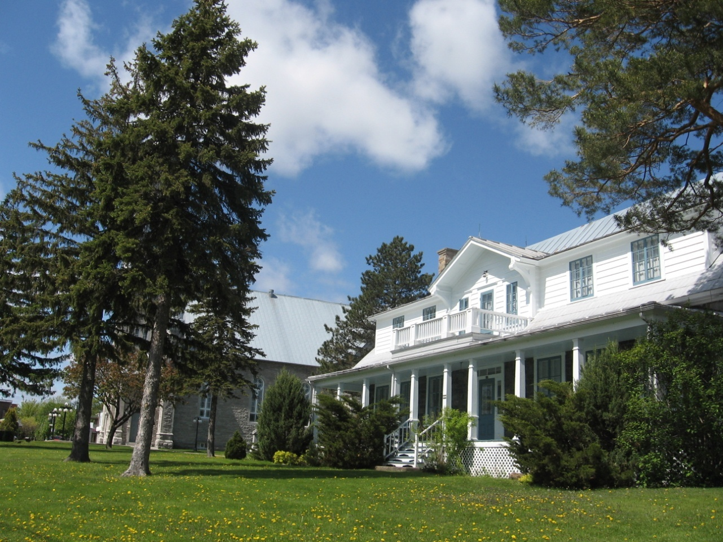
The Rectory: A Welcoming Woman
La rectoría parroquial: una mujer acojedora

Slide 15
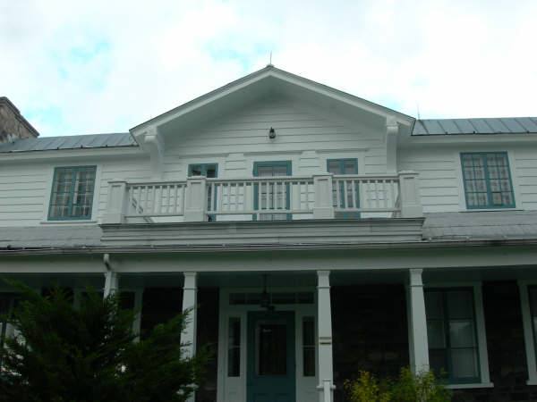
Eulalie’s new home for 12 years: Eulalie’s room on the left, Melodie’s on the right, sitting room in the middle.
El hogar de Eulalia por 12 años: su cuarto a la izquierda, el de Melodie a la derecha.

Slide 16
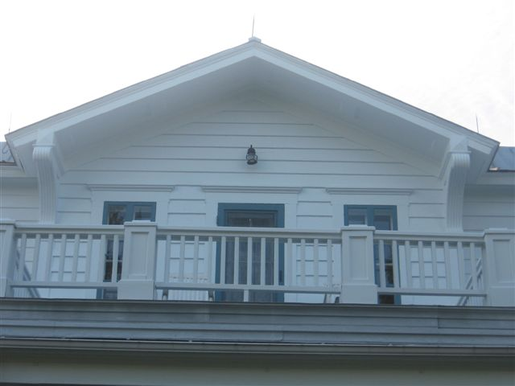
View of the River and St. Hilaire Church
Vista del río y de la Iglesia San Hilarión

Slide 17
Eulalie’s Leadership
Liderazgo de Eulalia
1831: Head of the household , her friend Melodie came to help
1841: Crossed the river to St. Hilaire to see her spiritual director Fr. Odilin, pastor, then Father Telmon OMI.
Tremendous strides in her prayer life.
Made private vows along with her friend, Melodie

Slide 18
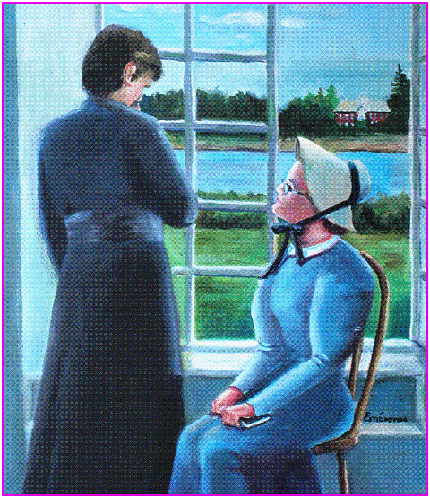
Counselor to Priests Who Came to Rest

Slide 19
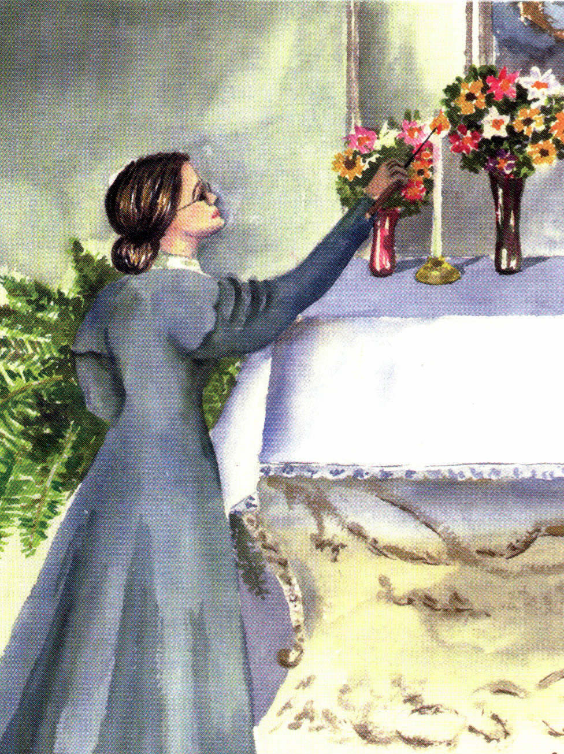
Trained the Sacristans
Entrenaba a las sacristanas

Slide 20
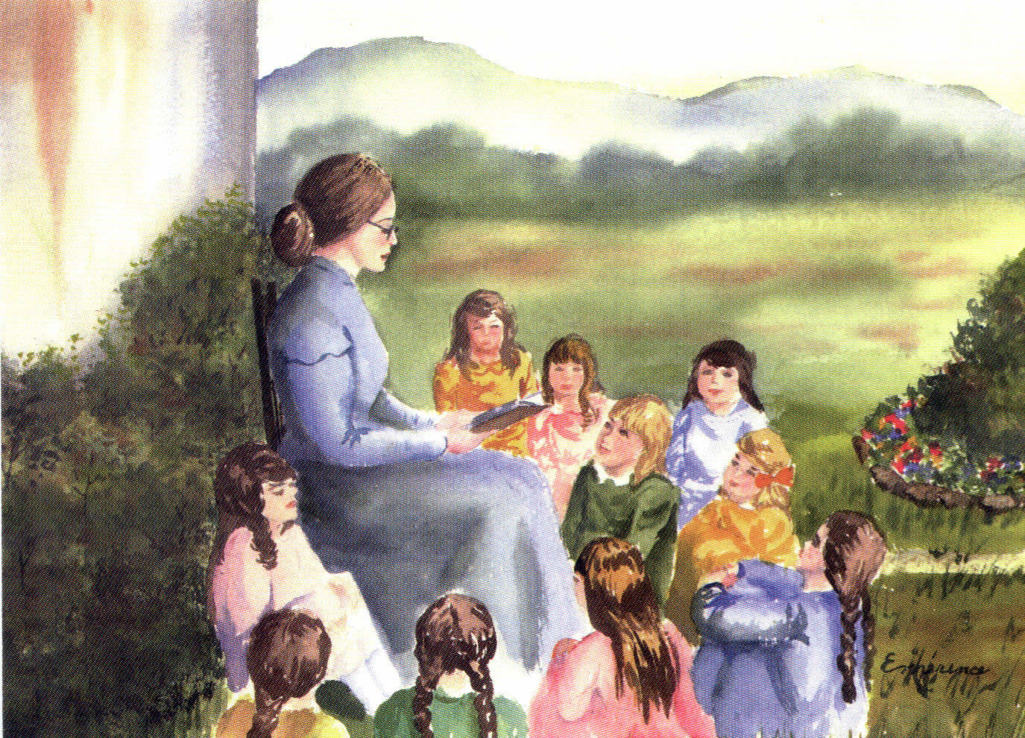
Dedication to Education in the Faith
Dedicación a la educación en la fe

Slide 21
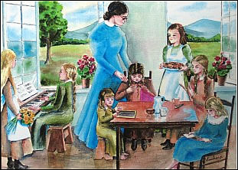
Full Development of the human person
Desarrollo integral de la persona

Slide 22
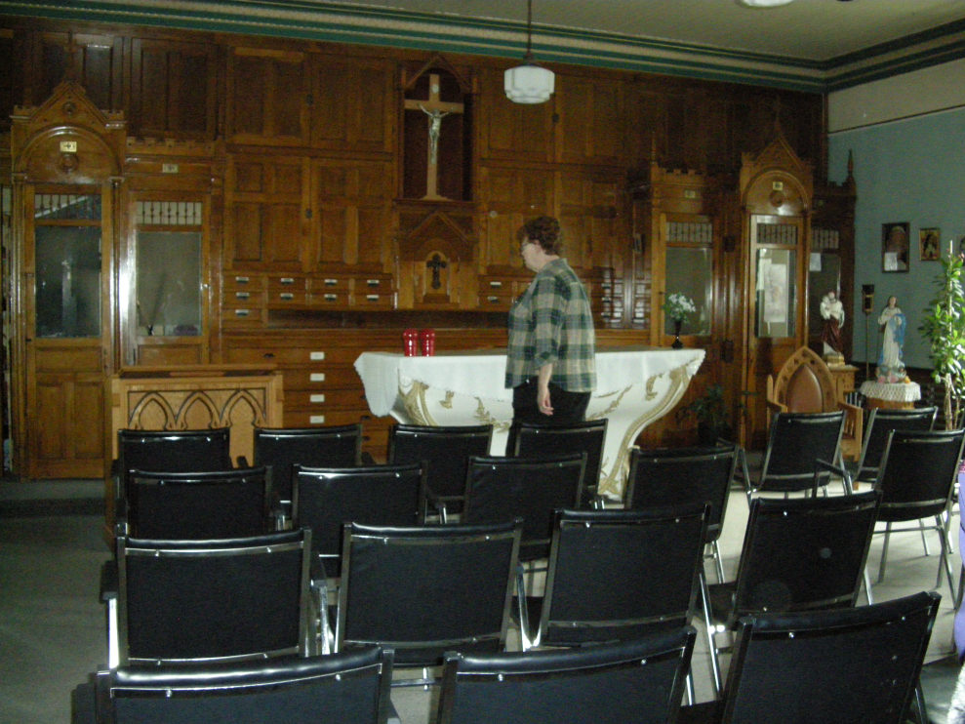
1842: First elected president of the Congregation of the Children of Mary (Daughters of Mary Immaculate). Becomes the spiritual leader of the group.
(Photo of the actual place where they meet)

Slide 23
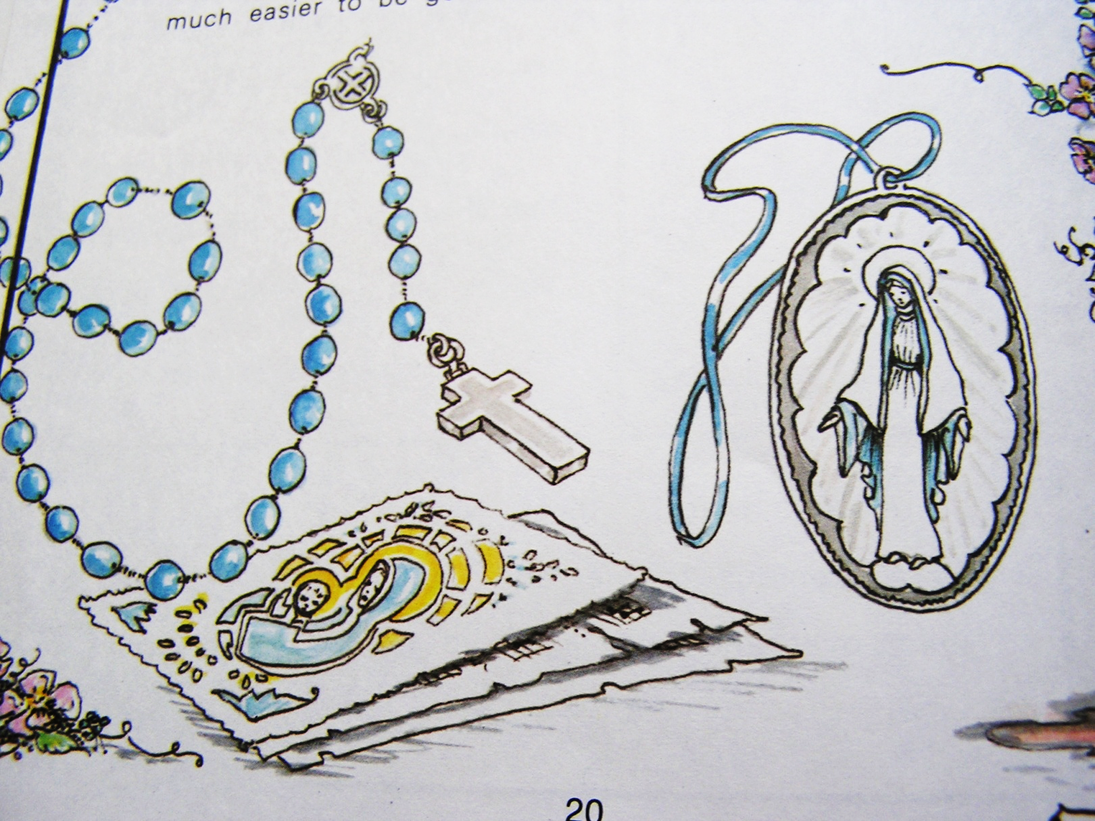
Prayer Aids for the Daughters of Mary
Ayudas para la oración de las Hijas de María

Slide 24
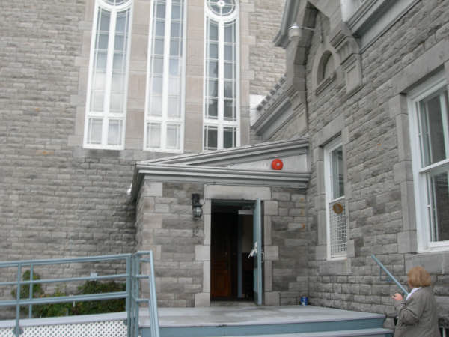
Entrance to the Sacristy from the Rectory
Entrada a la sacristía desde la rectoría

Slide 25
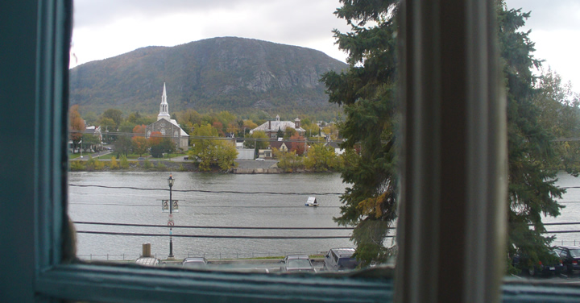
The arrival of the Oblates in St. Hilaire.
Eulalie goes there for spiritual direction
Fr. Odilin, pastor, then Father Telmon OMI.
Makes private vows along with Melodie

Slide 26
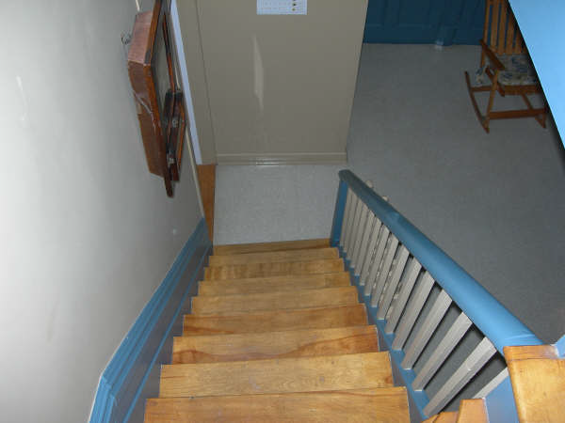
Stairs Leading to the Kitchen from the Ladies Bedrooms
Escaleras que bajan a la cocina desde los dormitorios de mujeres

Slide 27
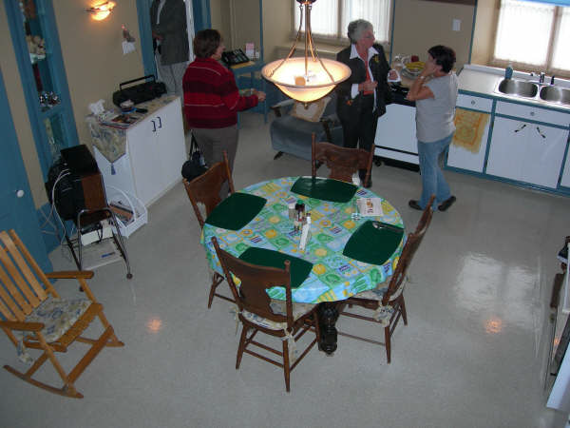

Slide 28
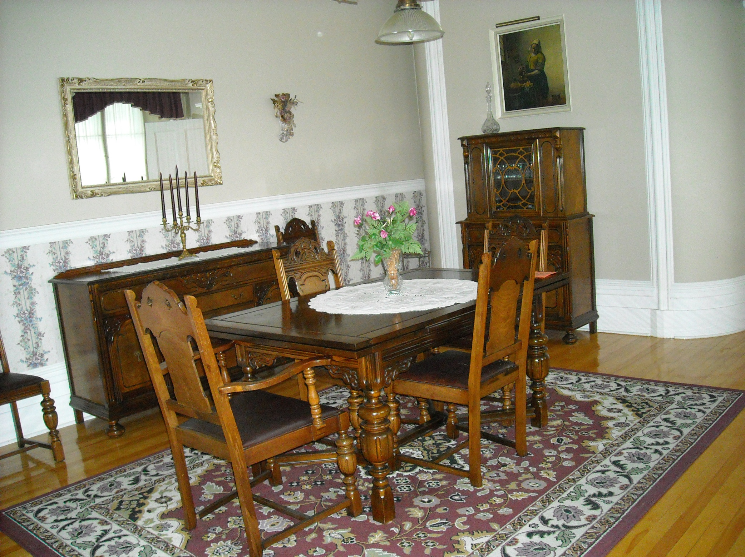
Comedor
Dining room

Slide 29
Foundation, Formation,
First Superior
1843: Bishop Ignace Bourget asks Eulalie to found a teaching congregation for young people.
1843, October 28: Eulalie and Melodie join Henriette Céré in her school in Longueuil and their formation begins with Father Jean-Marie François Allard, O.M.I.
1843, November 15th : arrival of Salomé Martin, an experienced teacher
January 1844: arrival of long awaited Hedwidge Davignon, also an experienced teacher
December 8th, 1844: the three foundresses make their first vows and the Congregation was founded.
The bishop named Sister Marie-Rose first superior knowing she was the soul of the community.

Slide 30
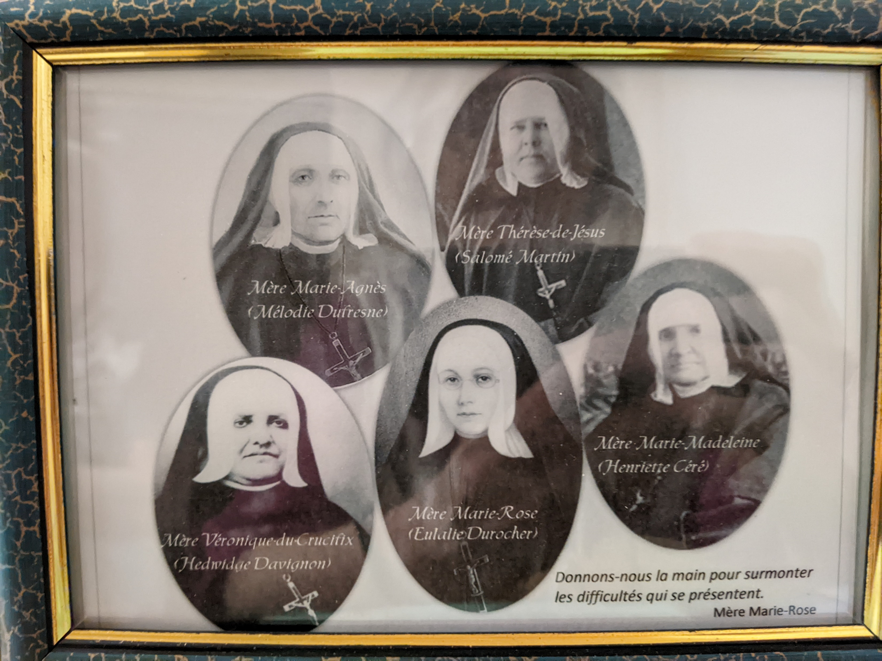

Slide 31
The Longueuil School and Beginning of the Expansion
First establishment’s success became the success of the congregation, due to a small group of young women who founded the first entirely Canadian teaching community.
Course of studies was complete and advanced for its time – French and English, oral and written, Religion and the arts as well as all aspects of house management
Introduction of the Children of Mary in the school
MMR knew that children learn best in an atmosphere of joy and relaxation.
1846, September: founding of the Belouil School, Theresa of Jesus, first superior, remained MMR’s favorite resting spot for the novices

Slide 32
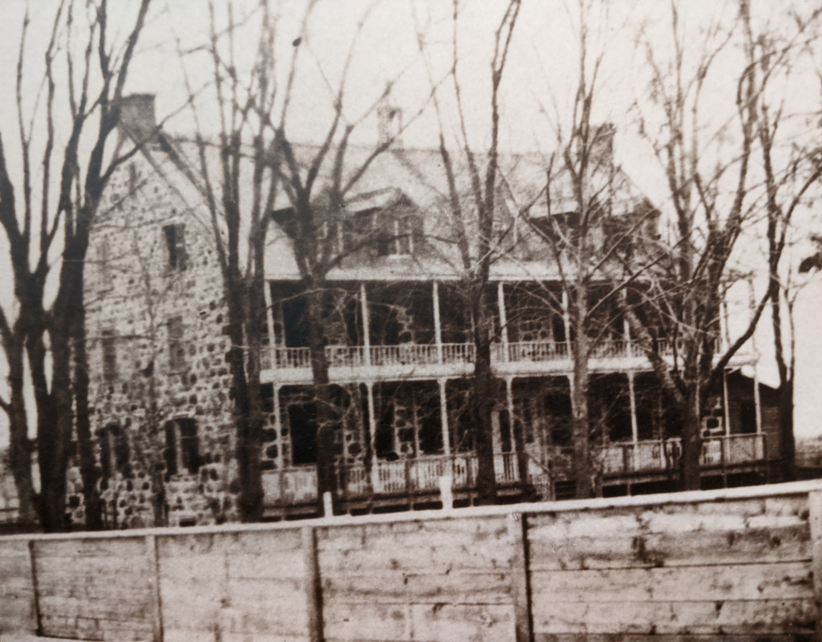

Slide 33
Mission Statement (SNJM)
The Sisters of the Holy Names of Jesus and Mary (SNJM) is an international congregation of Catholic Sisters, Associates and Lay Consecrated who are dedicated to the full development of the human person through education, social justice, contemplation and the arts. Our work occurs in settings including preschools, elementary and high schools, parishes, tutoring centers, graduate programs, studios, prisons, immigrant centers, clinics, spirituality and retreat centers, and in programs and communities that seek a Gospel path and to promote systemic change.

Slide 34
Constitutions on Education
“Education in the faith demands of us active involvement in the promotion of justice…
We are challenged by the Gospel and by the needs of society to unite our efforts with those around us to attain for all people conditions of life more equitable and more worthy of human dignity.”

Slide 35
Acts of the General Chapters
1991: Liberating action:
As SNJMs we are called
To give new life to the expression of our charism in our time
We believe that liberating action,
Which aims at the full development of the human person,
Is at the heart of our mission of education
in all our ministries

Slide 36
We commit ourselves to use our corporate power effectively in solidarity with people who are impoverished…
In collaboration with other networks, we will create and support alternative projects (cooperatives, associations, collective projects, etc.) which empower people who are impoverished to be artisans of their own liberation
Acts of the General Chapter in 1996, Justice

Slide 37
Questions for the
Next Session on Prayer
Describe the different stages of your life of prayer.
How did you pray as a child? Adolescent? In your youth?
Where are you now in your life of prayer?
What is your favorite way of praying?

Slide 38
Closing prayer
Reading from Matthew: 5, 13-16
“You are the salt of the earth; but if salt has lost its taste, how can its saltiness be restored? It is no longer good for anything, but is thrown out and trampled under foot.
You are the light of the world. A city built on a hill cannot be hid. No one after lighting a lamp puts it under the bushel basket, but on the lampstand, and it gives light to all in the house. In the same way, let your light shine before others, so that they may see your good works and give glory to your Father in heaven”.

Slide 39
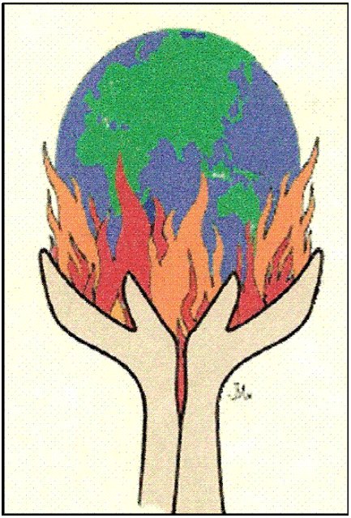
“I have come to cast fire upon the earth!”
“He venido a encender fuego sobre la tierra!”

Slide 40
https://youtu.be/FcD9uhRC3Ew

